Slide 1
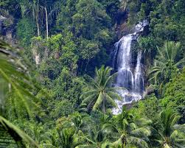
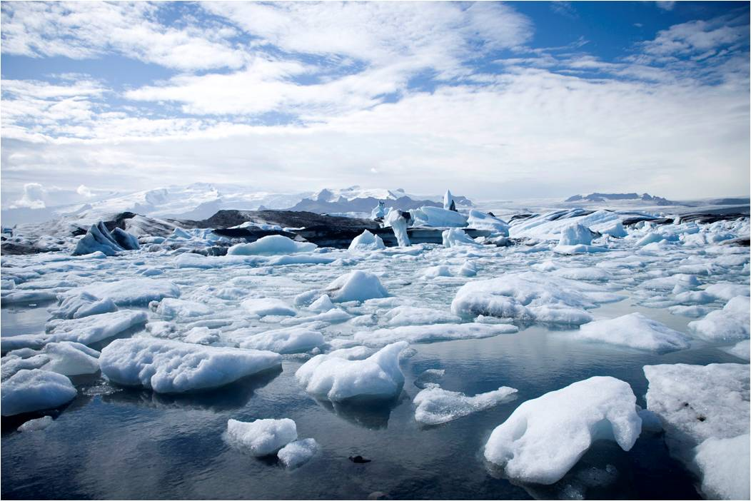
Would you rather……..
GCSE Geography example
…live in a tropical rainforest or cold environment
Personally, I would rather live in… because… furthermore…
In your answer you must include;
1 case study
2 key terms
3 specific facts
In your answer try and…
Listen carefully to your partner
Take time to think of your reply
Use sentence stems and connectives

