Slide 1
Maintaining Biodiversity
By the end of the lesson you will be able to:
State the programmes that have been put in place to reduce the negative effects of humans on ecosystems. (4)
Describe the advantages and disadvantages of each programme. (6)
Explain why conservation programmes can be controversial. (8)
Skills – note making

Slide 2
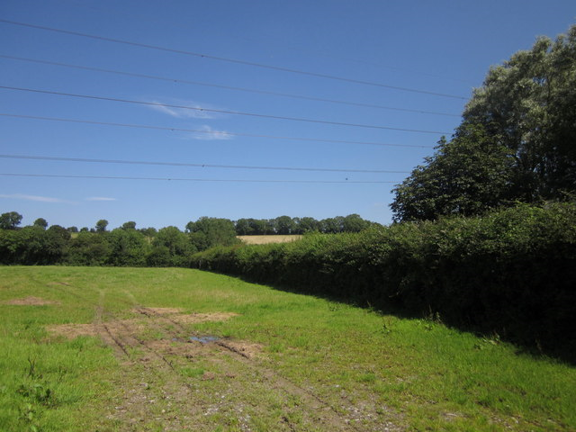

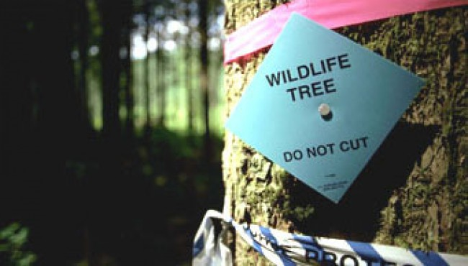

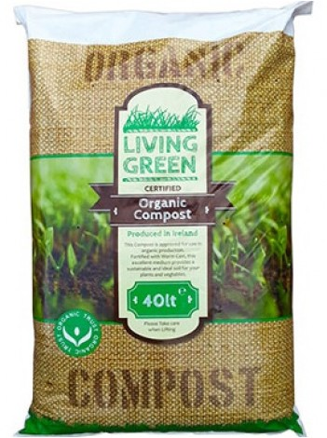


Guess the conservation programme……
Breeding programmes
Hedgerows around crop fields
Reducing deforestation
Protection of rare habitats
Recycling
Reduce carbon dioxide emissions
Peat free compost

Slide 3
Redhill Learning Skills

Slide 4
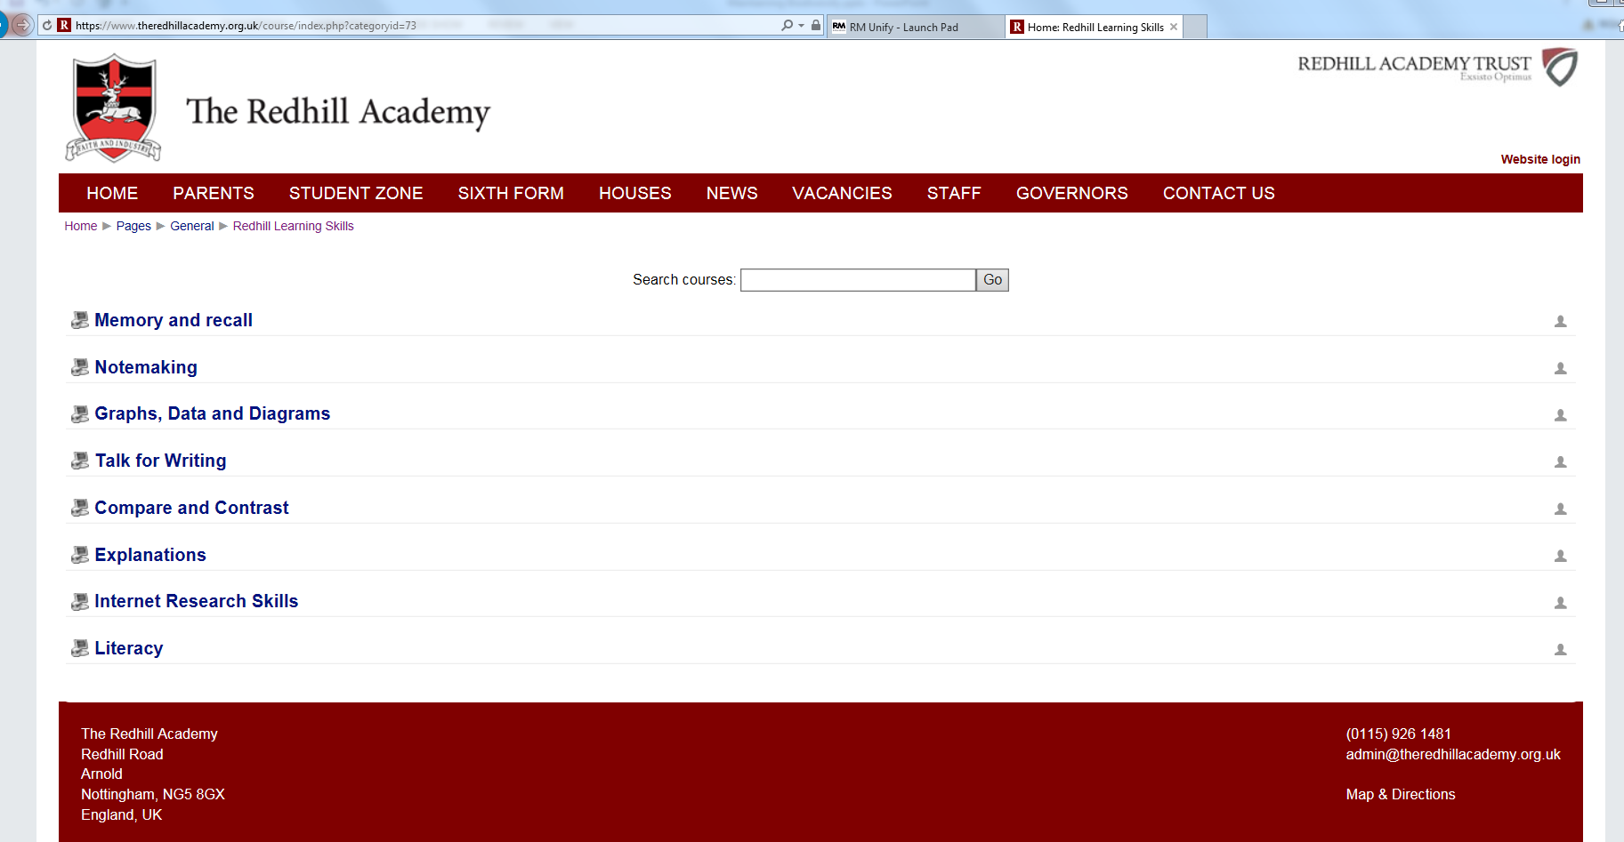

Slide 5

Note Taking Structure
P = Purpose – why are we doing this?
R = Read – for the gist then specifically
A = Apply – to a framework
N = Notes – techniques like abbreviations
K = Know it – an activity that does something with the notes

Slide 6
1. Purpose
You need to be able to do these things by the end of the lesson:
State the programmes that have been put in place to reduce the negative effects of humans on ecosystems. (4)
Describe the advantages and disadvantages of each programme. (6)
Explain why conservation programmes can be controversial. (8)

Slide 7

2. Read
One resource is not enough! Gather information from a number of places.
Read pages 298 – 299 of the big biology textbook.
Read pages 362 – 363 of the small biology textbook.

Slide 8
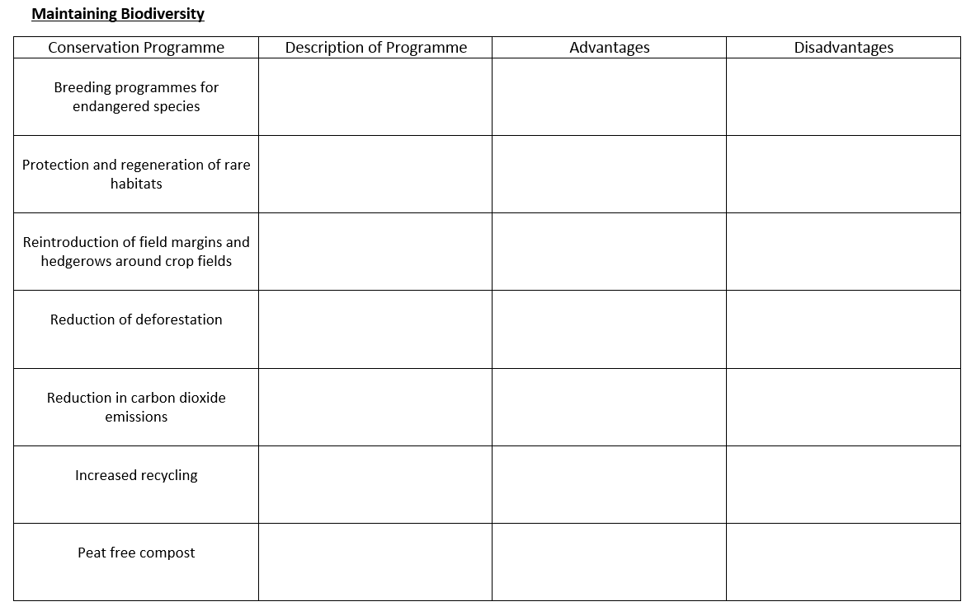
3. Apply to a Framework

Slide 9




4. Notes
1°
Text Speak

Slide 10
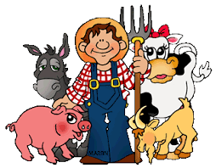
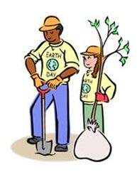

Possible sources of conflict
Think and discuss – why might there be issues between the conservationist and the following people:
v

Slide 11

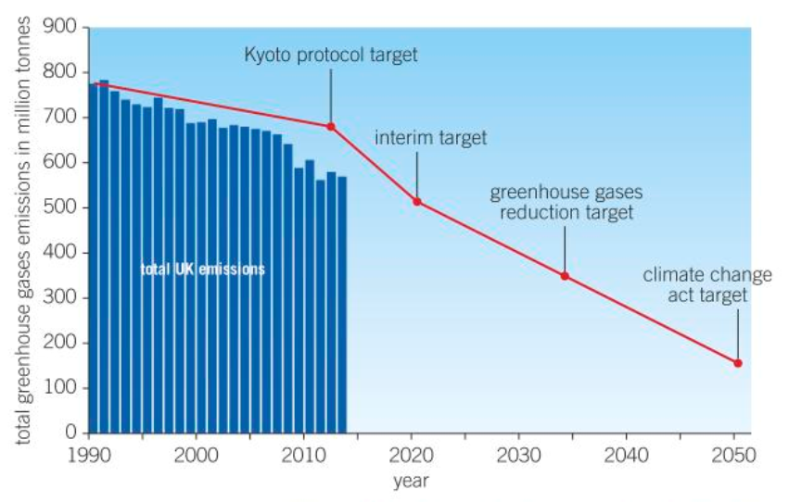
5. Know it – with out your notes!
Summarise the main ways people can help to maintain biodiversity. (5)
Suggest and example of where there may be conflict between maintaining biodiversity and human needs. (4)
Describe the trend in CO₂ emissions in the UK since 1990. (2)
Suggests how this data demonstrates the effect on governments on carbon emission. (3)
Answer the exam Q on recycling.

Slide 12
Mark Scheme
1.
breeding programmes for endangered species – restoring endangered species to sustainable populations,
protection and regeneration of rare habitats – protecting different animals and plants,
reintroduction of field margins and hedgerows – allowing biodiversity to be maintained in agricultural land,
reduction of deforestation – maintaining habitats,
recycling resources – reducing habitat loss and pollution

Slide 13
Mark Scheme
2. For example…….
increased field margins limiting land available for food production,
• reduction of deforestation limiting land available for food production,
• taxes on landfill waste increasing costs to businesses

Slide 14
Mark Scheme
3.
General decrease in CO₂ emissions.
Data quote – for example, “in 1990 the total greenhouse gas emissions was 790 million tonnes, but in 2010 the greenhouse gas emissions had fallen to 600 million tonnes.”

Slide 15
Mark Scheme
4.
Data suggests that Kyoto agreement drove UK government to take action to limit carbon dioxide emissions
and that government intervention via legislation
has been successful.

