Slide 1
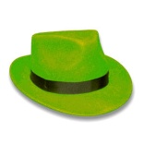
Evaluate the use of stem cells to treat paralysis.
What is your gut feeling about stem cell research? | What are the key facts?
What are some positive things about stem cell research? | What are some negative things about stem cell research?
What are the possible alternatives treatments for a person with paralysis? | Which hat did you find the easiest and why? Which hat did you find the most difficult and why? What strategies did other people use that might have been useful to you? In which other lessons would this strategy of evaluating be useful?

