Slide 1

Creativity is intelligence having fun

Slide 2
2 Minutes – Team Name
End

Slide 3
Tissue Box Challenge
Invent a new brand of tissues.
Target market
Product (size, quality, packaging)
Price
Promotion
Place (where will you sell it)

Slide 4
Learning Aim:
To unleash your inner business persona
Learning Outcomes
Must: (D/E)
  Contribute to the group discussion and generate at least 1 idea
Should: (B/C/D)
  Analyse the benefits and limitations of each option
Could: (A/B)
  Evaluate the choices and make an informed final decision
Notes:
This is a left vague at the moment - introducing the students to terminology & skills

Slide 5
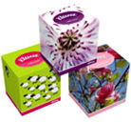
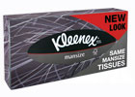
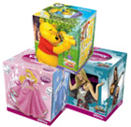



Things to consider…
Who is your target market
  How will your brand appeal to your target market?

Slide 6
Task – 1 Generating Business Ideas
Individually, every person in the group needs to come up with at least 1 idea to discuss with the group.
Original ideas
Adapting existing products/services/ideas
Notes:
Emphasis is to get in the habit of making contributions and also everyone in the team having valid points and an equal voice

Slide 7

Task 2
You have 10 minutes to complete this activity
In small groups – pool your new business ideas
Shortlist based on small business with limited resources
Rank your ideas in order of “likeliness to succeed”
Discuss and agree the ranking
Notes:
Think – pair – share
What is it and characteristics
Advantages
Disadvantages

Slide 8
Plenary
Each group feeds back their business idea:
What is the idea?
Where did the idea come from?
Why did the group consider it the most likely to succeed?

Slide 9
Lesson 2

Slide 10

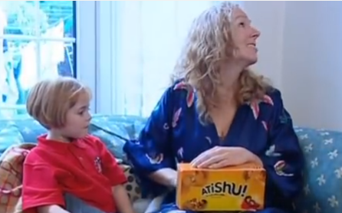
Think you can do better than
Atishu? https://www.youtube.com/watch?v=eEugOBc_1ns

Slide 11
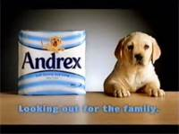

Team Challenge
Branding
4Ps
Target market
Product Name
Product Packaging
Price
Product
Place
Promotion
Everyone must take an active part.

Slide 12
You have two lessons:
Create a brand identity, including name and logo
Research packaging and produce a prototype box
Write an advertising slogan
Create a promotional poster
Create a presentation on the marketing mix, explaining
  Product – it’s appeal to the target market and packaging
  Promotion – the brand identity and advertising slogan
  Price – retail price (research and justification needed)
  Place –where are you going to sell your product.

Slide 13
Things to consider…4P’s
PRODUCT
  It needs to have a UNIQUE SELLING POINT to make it different / better than competitors
  What will it look like? Logo / branding / packaging?
  It needs to appeal to your target market

Slide 14
Things to consider…4P’s
PRICE
  How much can you charge for your new improved box of tissues?
  How much will your target market be prepared to pay?
PLACE
  Where will your target market expect to buy this product from?

Slide 15


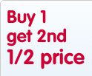
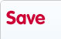
Things to consider…4P’s
PROMOTION
  How do you plan to let your target market know about your product? How will you advertise it?
  How will you persuade them to buy it?
  Are you going to do any introductory special offers?

Slide 16
By the end of today:
Prototype box
Advertising slogan
Promotional poster
A3 Presentation (4Ps)
Product UNIQUE SELLING POINT to make it different / better than competitors Logo / branding / packaging? Appeal to your target market | Price How much can you charge for your new improved box of tissues? How much will your target market be prepared to pay?
Place Where will your target market expect to buy this product from? | Promotion How will you advertise it? How will you persuade them to buy it? Are you going to do any introductory special offers?

Slide 17
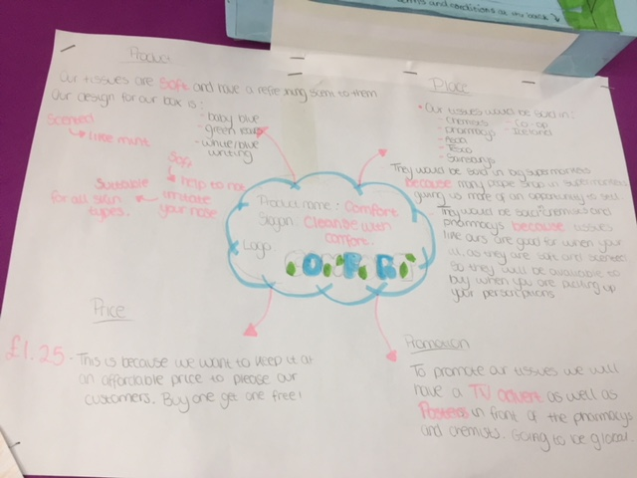
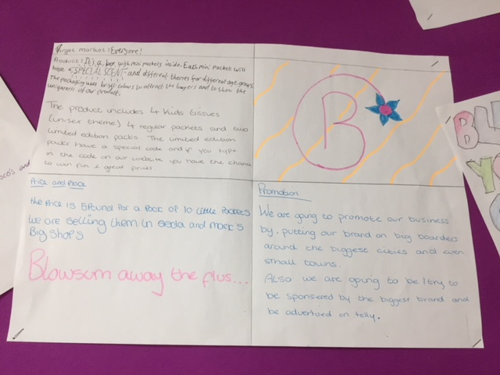

Slide 18


Hired or Fired?
Team “pitch”
  Present your idea to the group –

Slide 19
Peer Evaluation
Write down two things that the team did well.
Write down two things you think they could improve.
Write down one thing that they thought of that you wish you had!

Slide 20
Well done!

