Slide 1
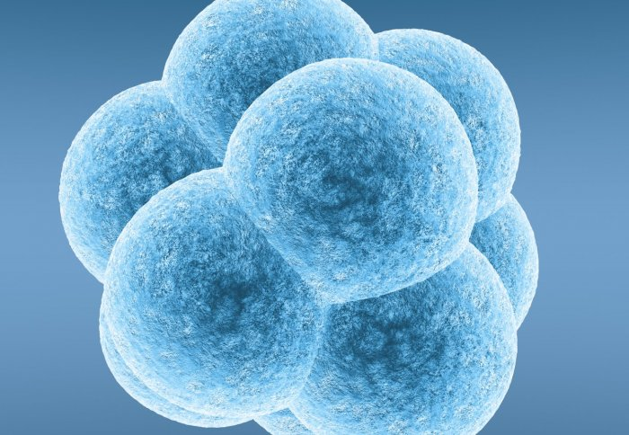
GCSE Biology example
Selecting embryos to ensure that they do not have a genetic disorder is morally wrong.
I (strongly) agree with this statement because . . .​
I (completely) disagree with this statement because . . . ​
We must consider . . . ​
I think that . . . ​
It is essential to . . .
Furthermore​
In addition​
​However​
Nevertheless​
On the other hand​
​Unless​
Except​
Perhaps​​
Notes:
KM

