Slide 1
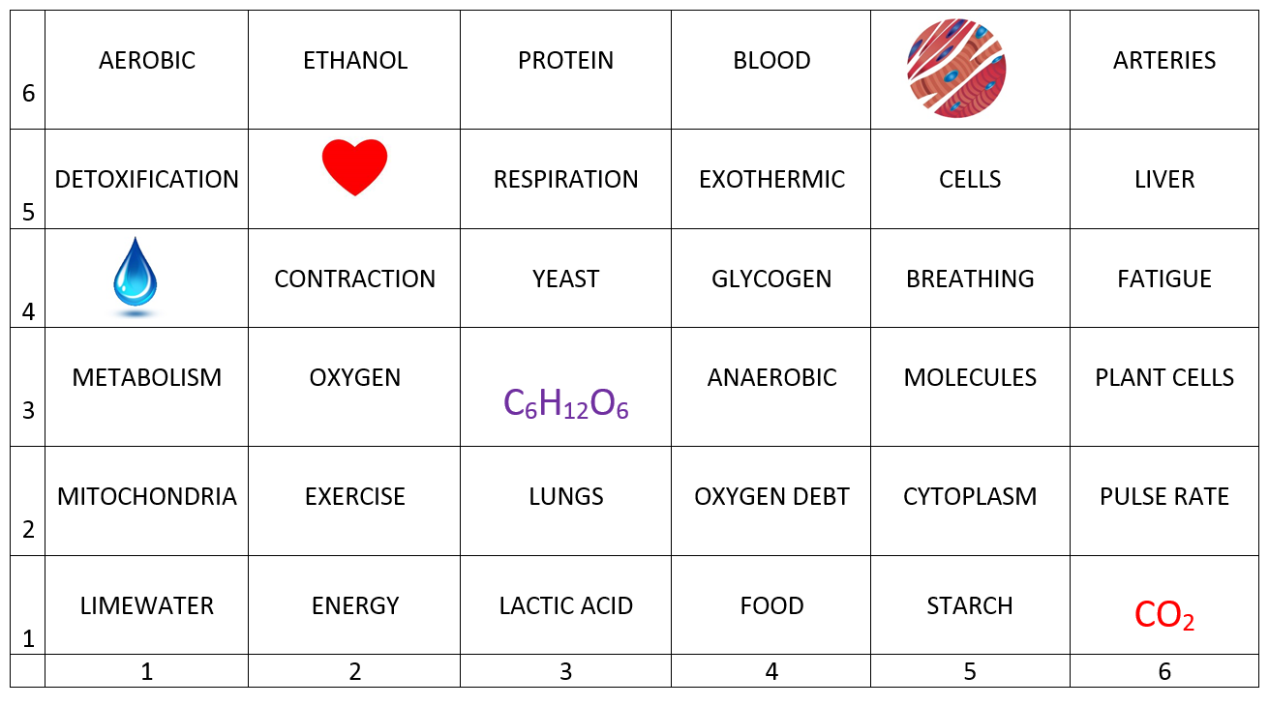
GCSE Biology Example - Respiration

