Slide 1


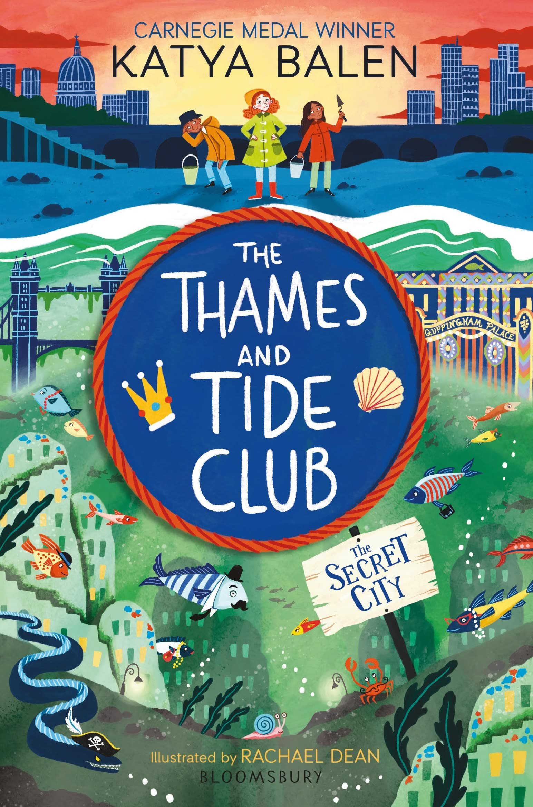
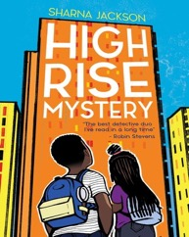
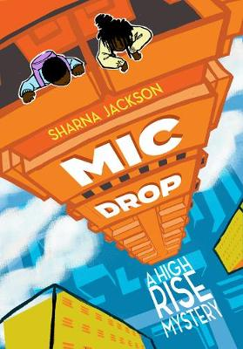
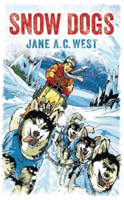
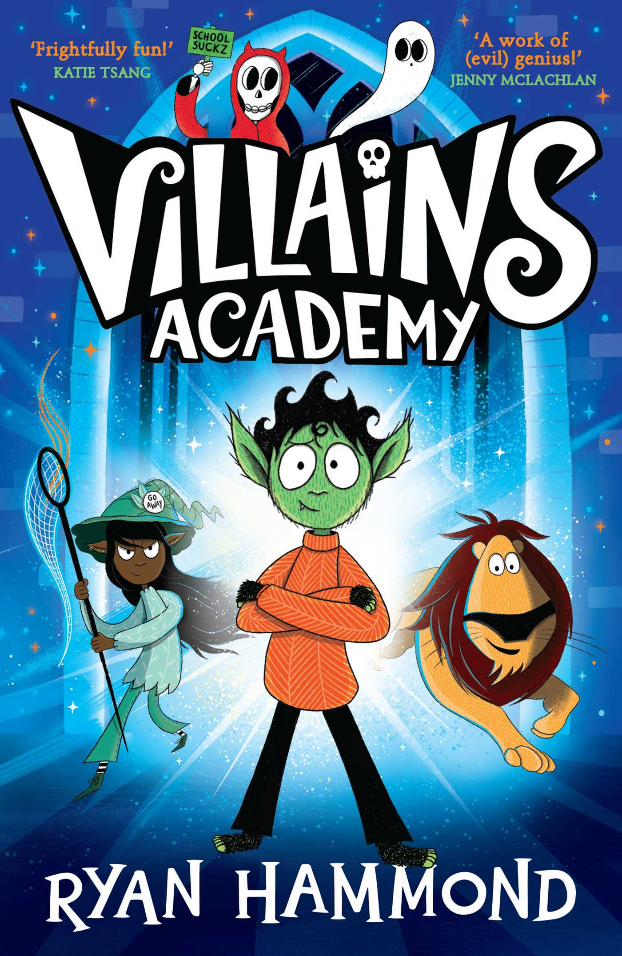
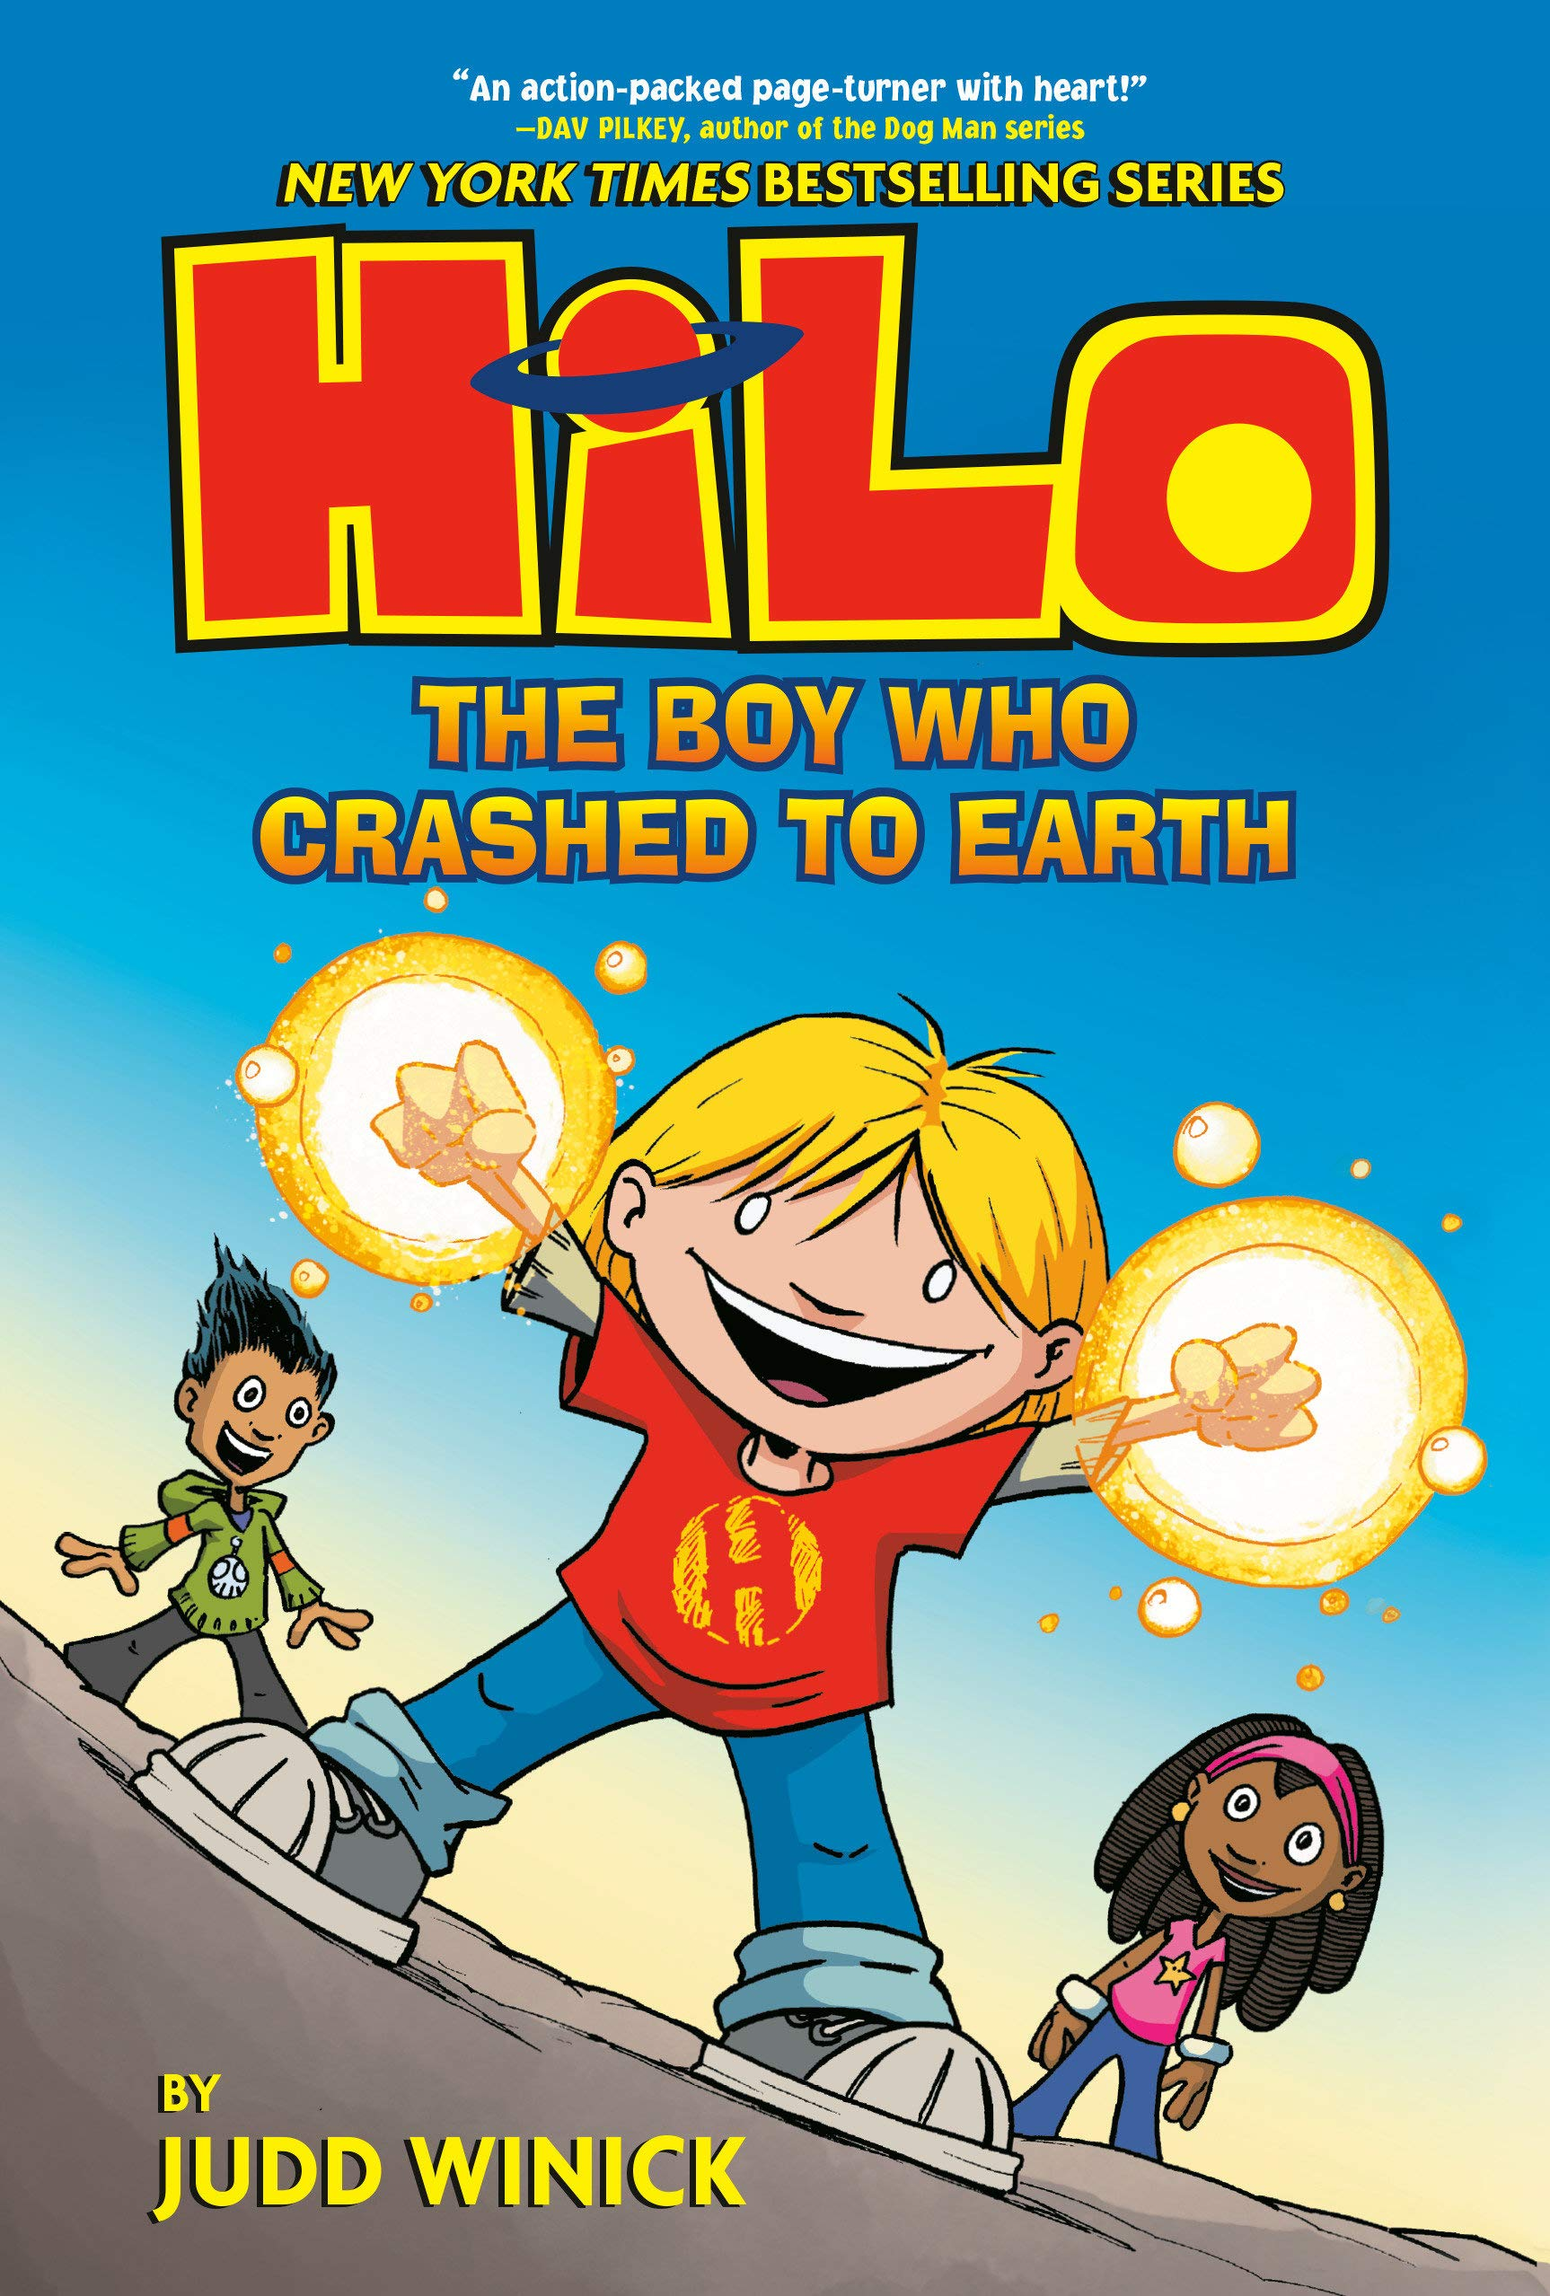
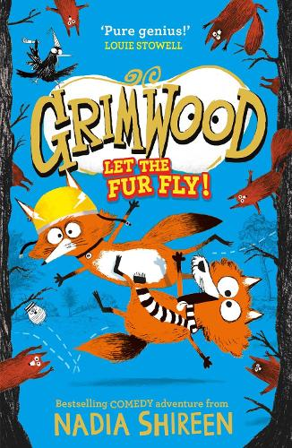
KS2 SAT Reading score of 80-90
Clem and her friends Ash and Zara are members of the Thames and Tide Club! Every weekend they go mudlarking by the river, searching for treasures that have washed up on the shore. Clem has found old things, new things and a whole heap of rubbish. But one day, she finds something really special. Something magical that belongs in the river and must be returned to it’s rightful owner, or else. Before they know it, the Thames and Tide Club are on the weirdest, wildest adventure they could possibly have imagined…
The Thames and Tide Club by Katya Balen
If this sounds good then you could also read…
High Rise Mystery & Mic Drop by Sharna Jackson
The Middler by Katie Applebaum
Snow Dogs by Jane West
Welcome to Villain’s Academy – the most prestigious villain school in the entire land. You will either leave here as a fully-formed villain…or in tatters.
It’s werewolf Bram’s first day at Villains Academy. He really doesn’t feel like a villain at all, but the coveted ‘Villain of the Week’ trophy is up for grabs and Bram knows he’ll have to dig deep. With the help of new friends Mona the elf-witch, Bryan the lion, Sheila the ghost and Tony the skeleton, can Bram find his inner badness and become the villain he’s always dreamed of being?
The Villains Academy by Ryan Hammond
If this sounds good then you could also read…
HILO: The Boy Who Crashed To Earth by Judd Winick
Grimwood: Let the Fur Fly by Nadia Shireen
Stalker by Helen Orme
Apple and Rain by Sarah Crossan

Slide 2
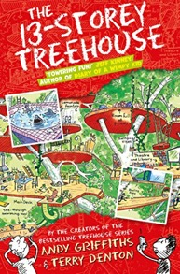
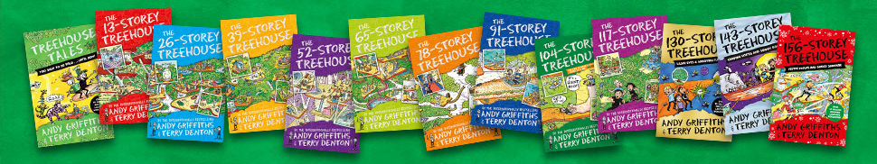

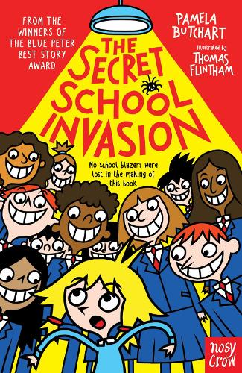
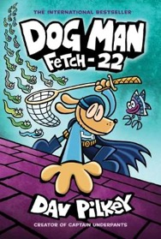
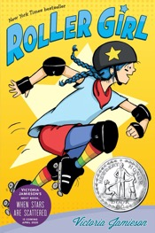
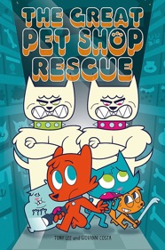
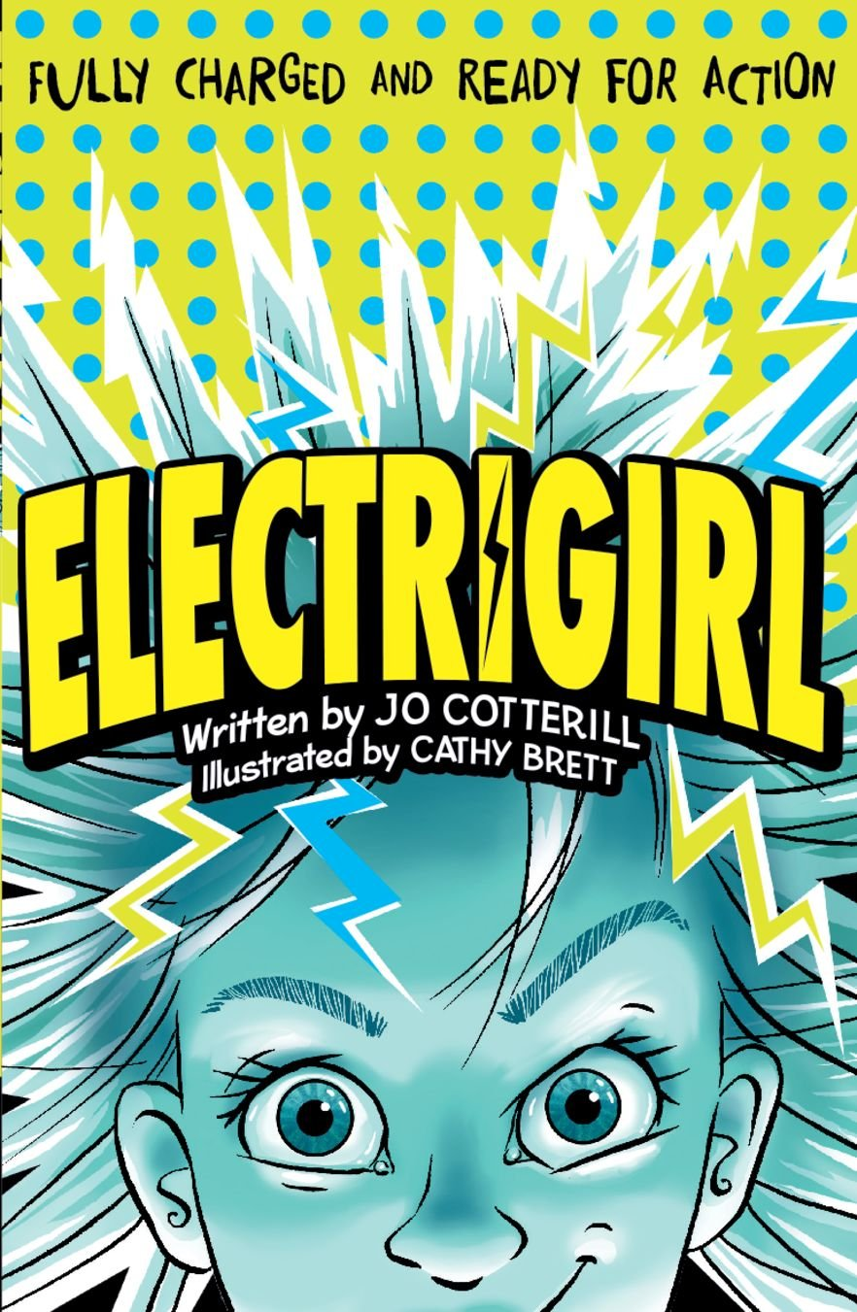
Perfect for Wimpy Kid fans, Andy and Terry have the best treehouse ever - complete with a bowling alley and a lemonade fountain! Andy and Terry are trying to work on their next book but are too busy with flying cats and sea-monkey mishaps! Can you read the whole series?
The 13-Storey Treehouse by Andy Griffith
If this sounds good then you could also read…
Press Start! By Thomas Flintham
The Secret School Invasion by Pamela Butchart
Dog Man: Fetch 22 by Dav Pilkey
Astrid has always done everything with her best friend Nicole. So when Astrid falls in love with roller derby and signs up for a summer camp, she's sure Nicole will be right by her side - until Nicole signs up for ballet camp instead, with Astrid's biggest rival. So begins the hardest summer of Astrid's life, as she struggles to stay on her skates, to learn who she is without Nicole . . . and to find out what it takes to be a strong, tough, awesome roller girl.
Roller Girl by Victoria Jamieson
If this sounds good then you could also read…
Ghosts by Raina Telgemeier
The Great Pet Shop Rescue by Tony Lee
Electrigirl by Jo Cotterill

Slide 3
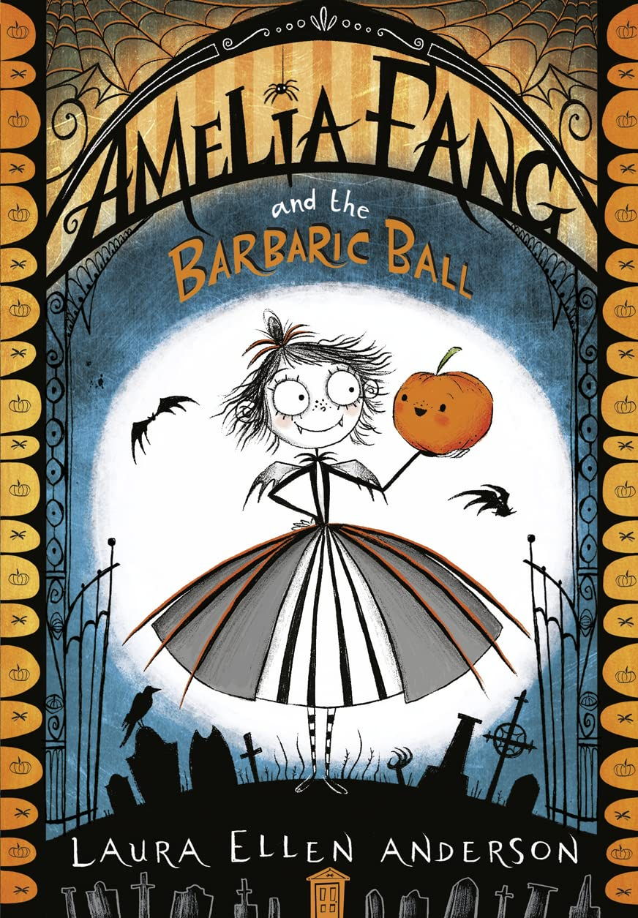
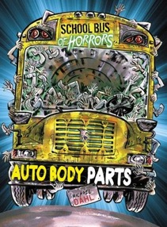

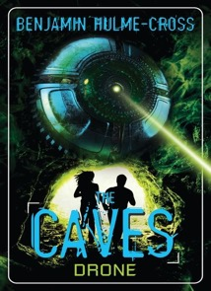

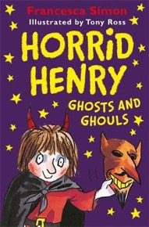
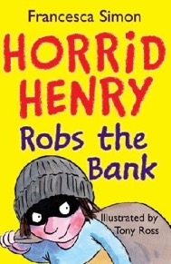
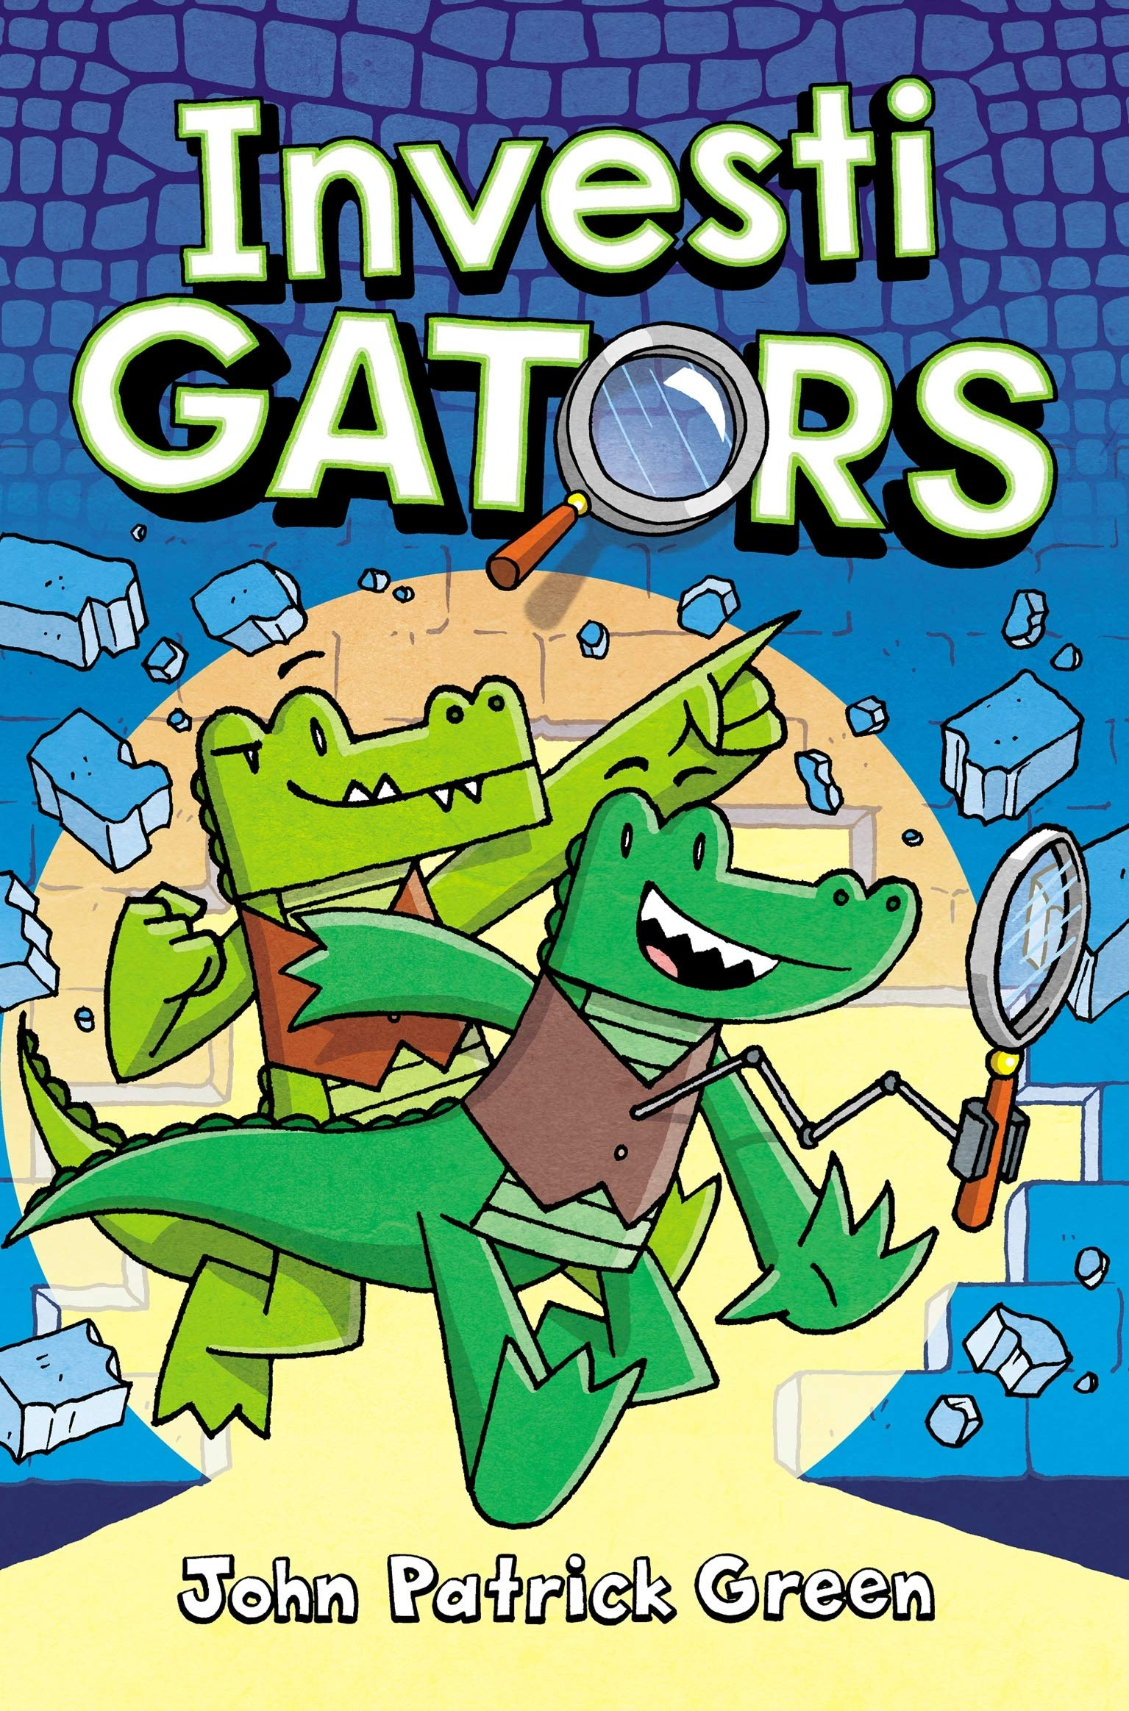
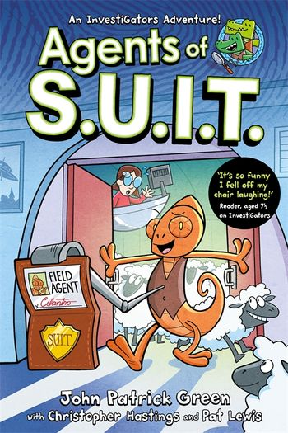
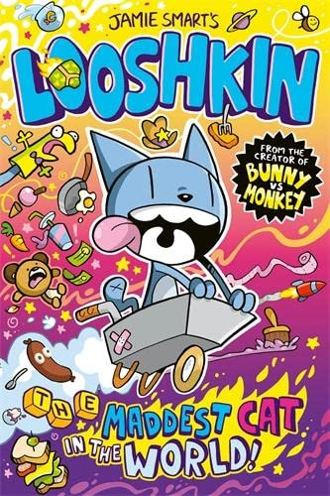
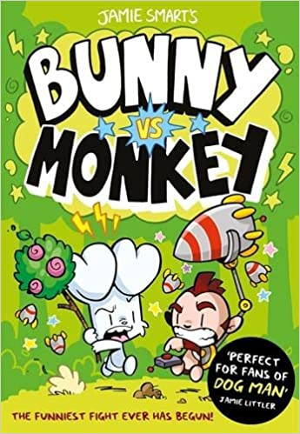
Welcome to the world of Nocturnia, where darkness reigns supreme, glitter is terrifying and unicorns are the stuff of nightmares! Amelia Fang would much rather hang out with her pet pumpkin Squashy and her friends Florence the yeti (don’t call her BEAST!) and Grimaldi the reaper than dance at her parents’ annual Barbaric Ball. And when the King’s spoiled son Tangine captures Squashy, Amelia and her friends must escape the party to plan a daring rescue! In their race against time, they begin to realise things in Nocturnia may not be quite what they seem…
Amelia Fang by Laura Ellen Anderson
If this sounds good then you could also read…
Shadow Girl by Sally Nicholls
Auto Body Parts by Michael Dahl
Love Bites by Jo Cotterill
Super Series
The Caves by Benjamin Hulme-Cross
Horrid Henry by Francesca Simon
Try out a
graphic
novel
InvestiGators by John Patrick Green
Agents of S.U.I.T. by John Patrick Green
Looshkin by Jamie Smart
Bunny vs Monkey by Jamie Smart

Slide 4
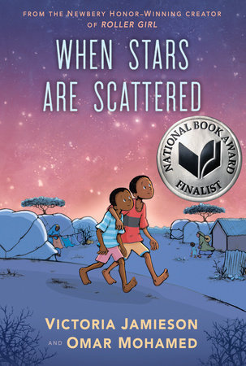
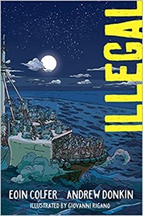
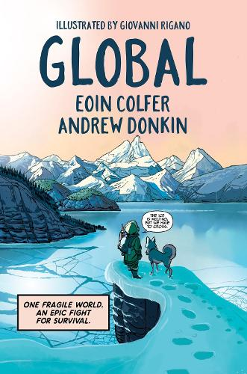
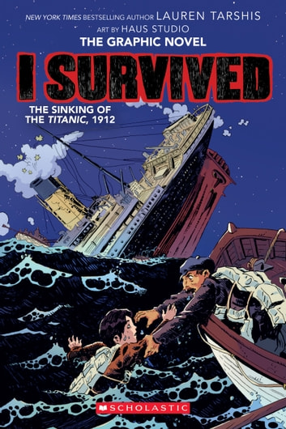
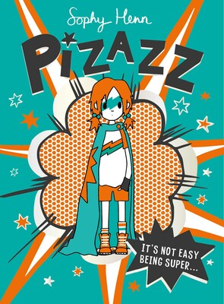
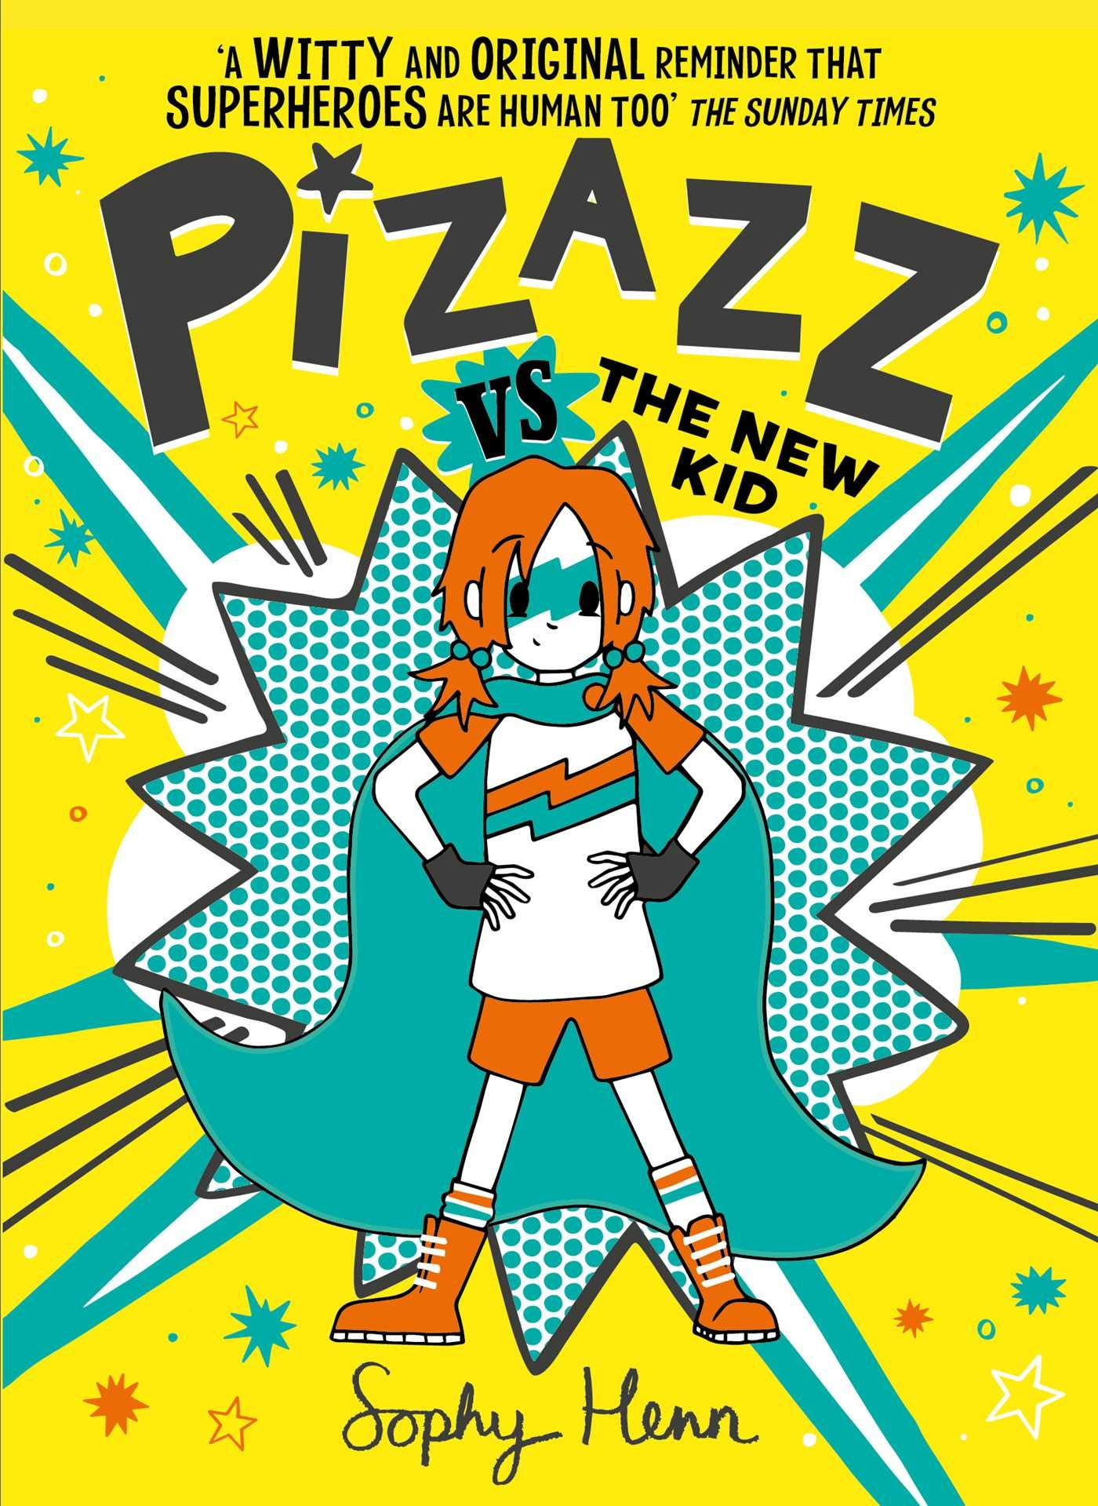
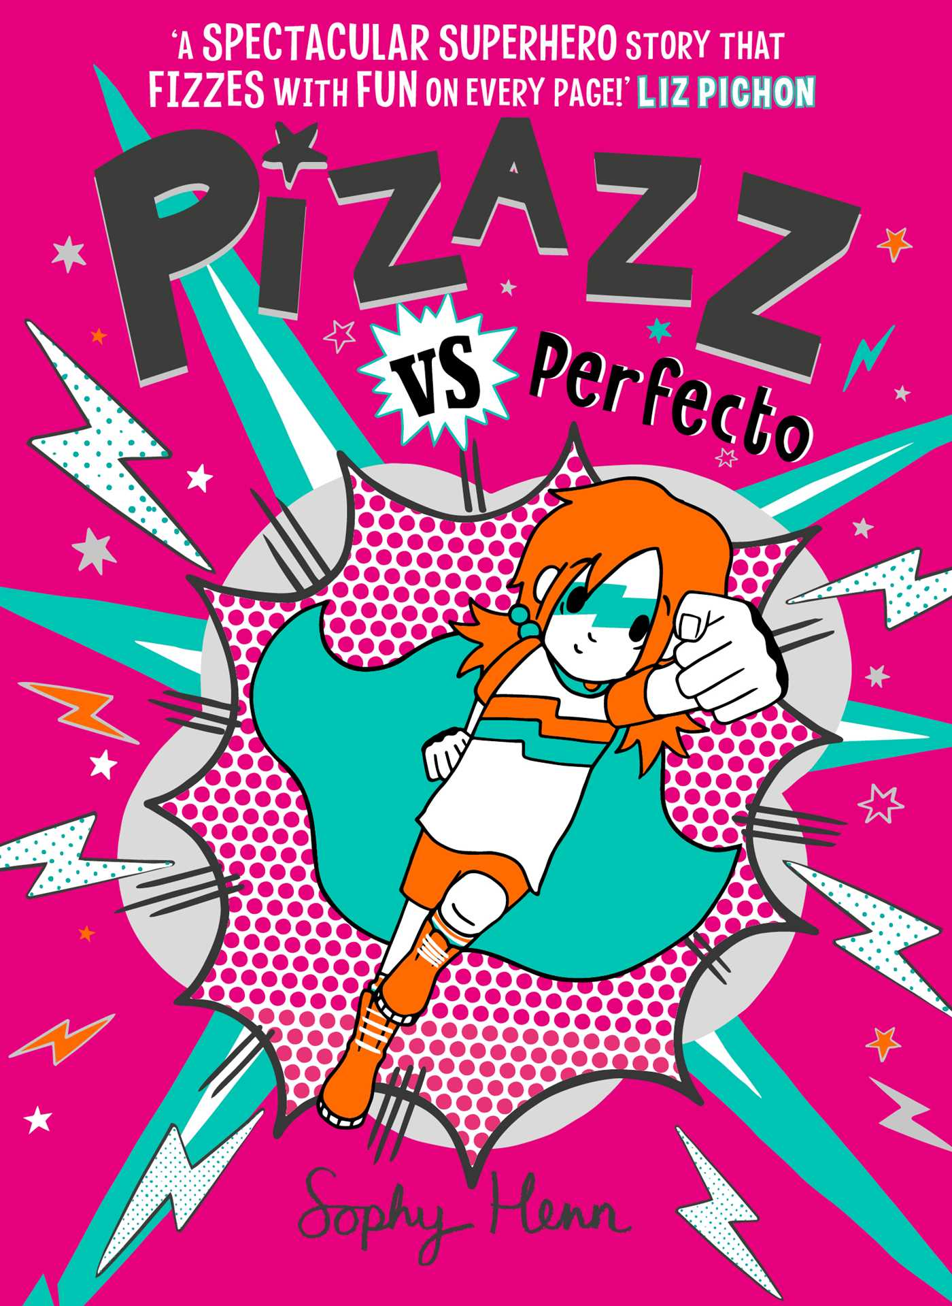
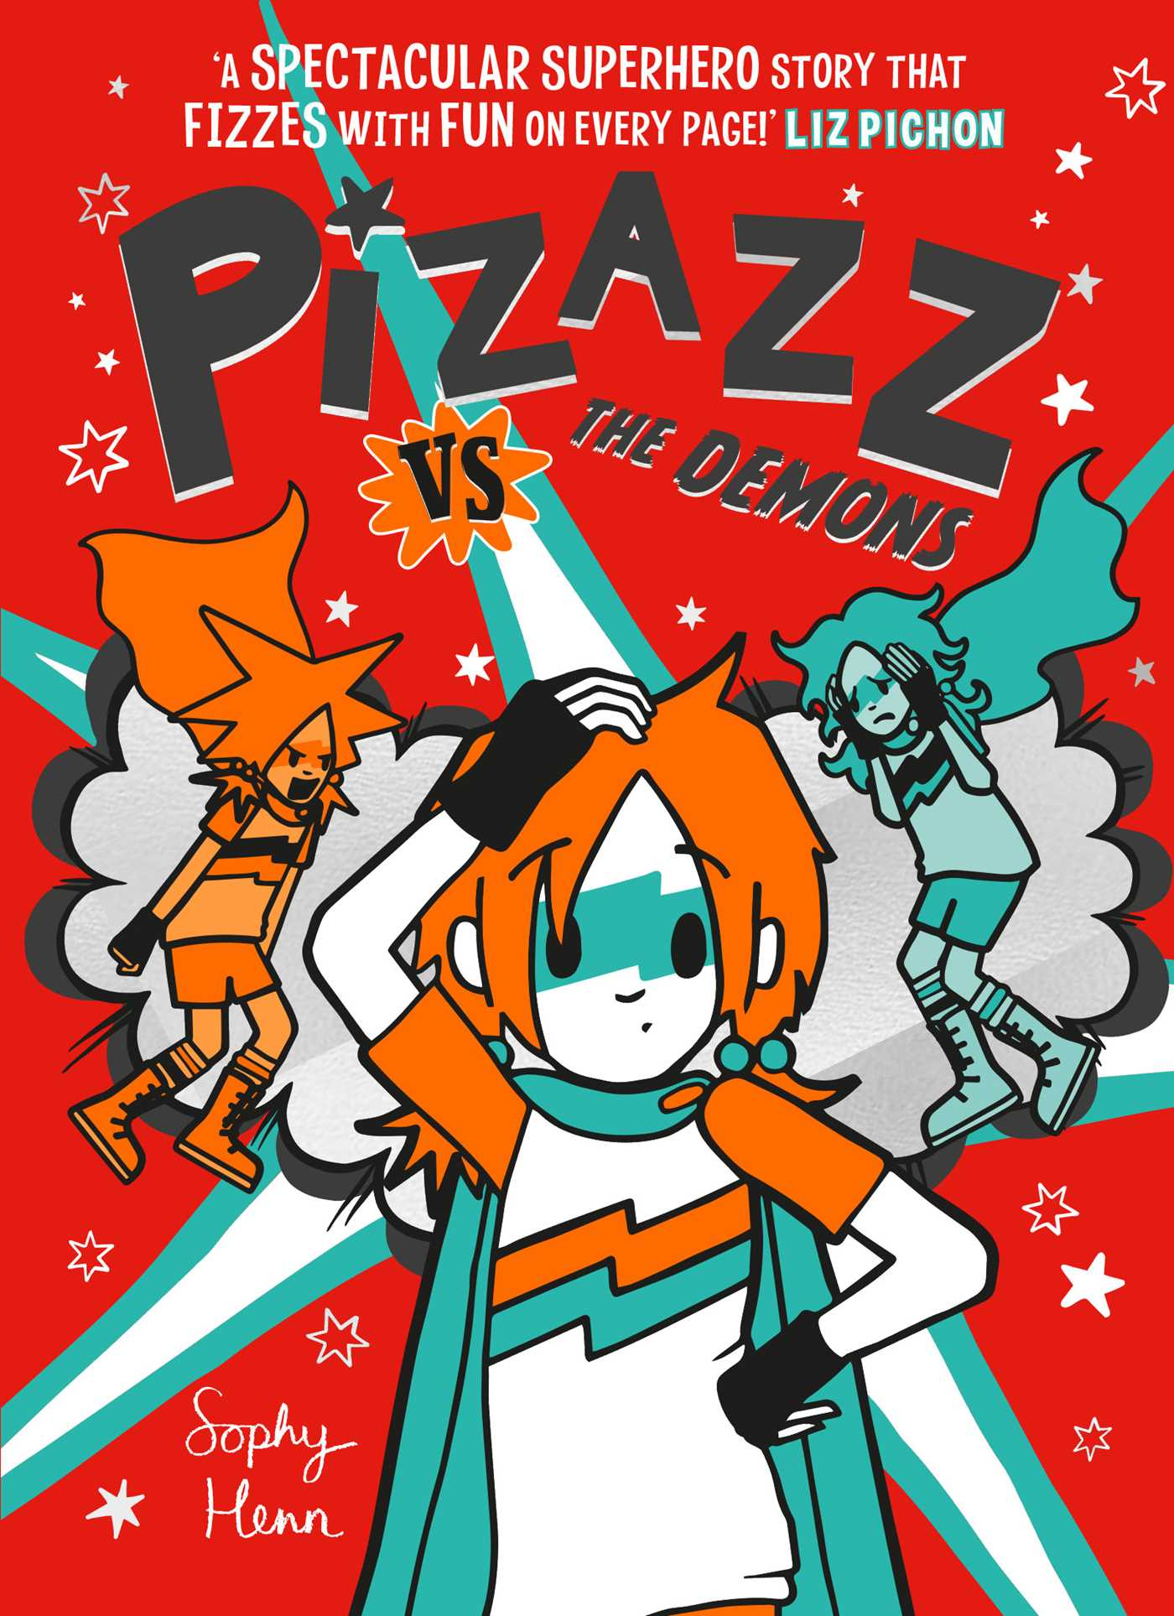
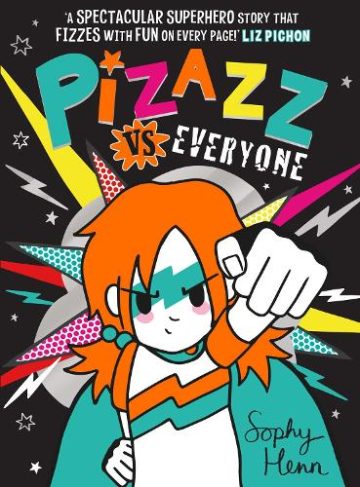
Omar and his younger brother, Hassan, have spent most of their lives in Dadaab, a refugee camp in Kenya. Life is hard there: never enough food, achingly dull, and without access to the medical care Omar knows his nonverbal brother needs. So when Omar has the opportunity to go to school, he knows it might be a chance to change their future . . . but it would also mean leaving his brother, the only family member he has left, every day.
Heartbreak, hope, and gentle humour exist together in this graphic novel about a childhood spent waiting, and a young man who is able to create a sense of family and home in the most difficult of settings.
When Stars are Scattered by Victoria Jamieson
If this sounds good you could also try these…
Illegal by Eoin Colfer and Andrew Donkin
Global by Eoin Colfer and Andrew Donkin
I Survived the Sinking of the Titanic
Pizazz is a superhero, but she hates her superpower. In fact, she hates it so much that sometimes she’d rather let the baddies win than have to use it. Compared with her superhero family, Pizazz would just much rather eat ice cream and play with her hamsters.
Yet when Pizazz becomes an eco-monitor at school, she finds out that a local business – run by the dad of one of her enemies – is planning to steamroller the nice local park and build a car park on it. Despite a disastrous initial presentation to the rather intimidating businessmen with her friend Ivy, Pizazz’s Grampa helps them hatch a plan which will bring the community together to protest the new car park – and, in so doing, provide an opportunity for Pizazz to use her actually quite fabulous superpower.
Pizazz by Sophy Henn
Try the whole series

