Slide 1




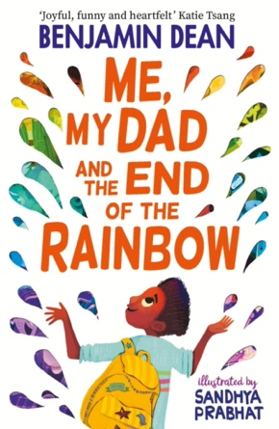

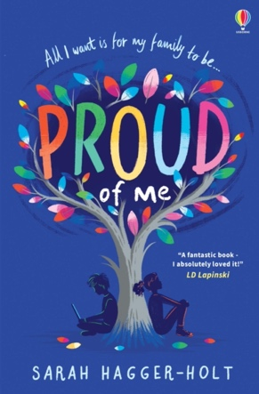

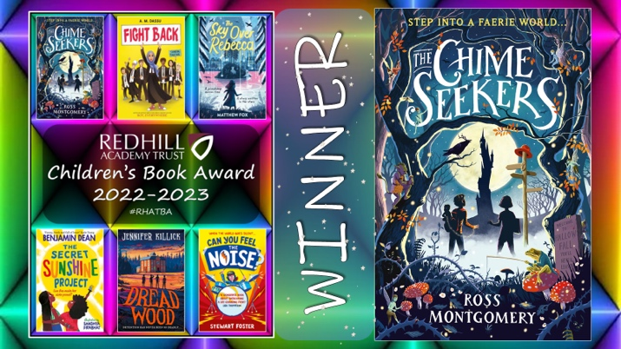
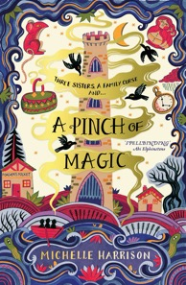

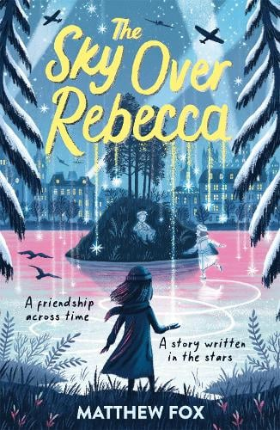

KS2 SAT Reading score of 90-105
Jamie Rambeau is a happy 11-year-old non-binary kid who likes nothing better than hanging out with their two best friends Daisy and Ash. But when the trio find out that they will be separated into one school for boys and one for girls, their friendship suddenly seems at risk. And when Jamie realises no one has thought about where they are going to go, they decided to take matters into their own hands and sort it all out once and for all. Set in and around Nottingham.
Jamie by LD Lapinski
If this sounds good then you could also read…
Me, My Dad and the End of the Rainbow by Benjamin Dean
The Secret Sunshine Project by Benjamin Dean
Proud of Me by Sarah Hagger-Holt
Glitter Boy by Ian Eagleton
When an evil faerie steals Yanni’s baby sister and swaps her for a changeling, Yanni is swept into a dangerous race against time to get her back. For faeries delight in tricks and rescuing her won’t be easy. With the help of his cousin, Amy, and the reluctant changeling, Yanni must travel to goblin palaces and battle-swept oceans, discovering ancient treasures and secrets along the way. Winner of The Redhill Academy Trust Children’s Book Award 2022-2023.
The Chime Seekers by Ross Montgomery
A Pinch of Magic by Michelle Harrison
A Place Called Perfect by Helena Duggan
The Sky Over Rebecca by Matthew Fox
The Last Wild by Piers Torday

Slide 2
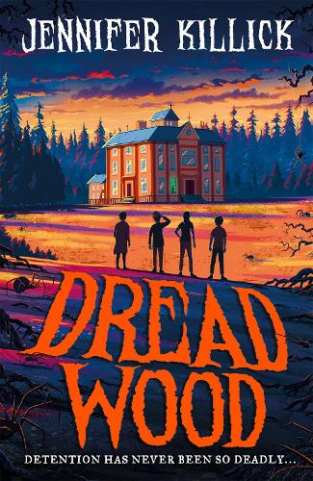
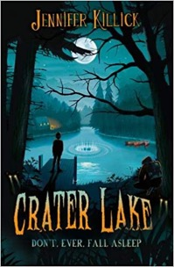

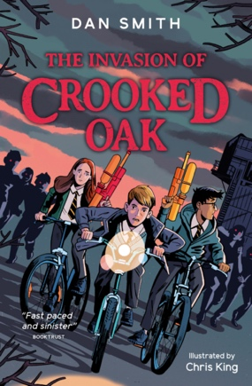
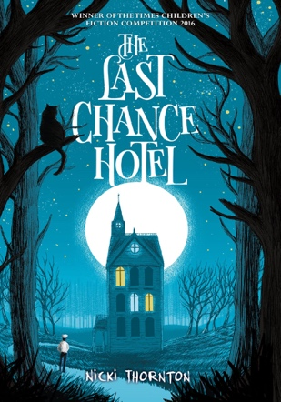
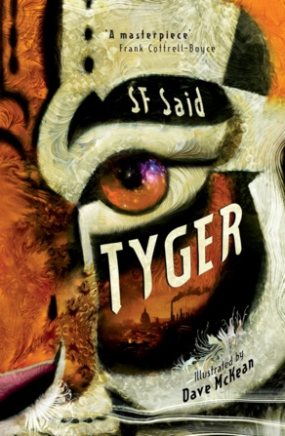
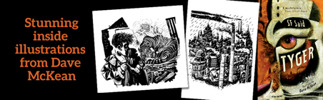



It’s basically the worst detention ever! When classmates (but not mate-mates) Hallie, Angelo, Gustav and Naira are forced to come to school on a Saturday, they think things can’t get much worse. But they’re wrong. Things are about to get seriously scary.
What has dragged their teacher underground? Why do the creepy caretakers keep humming the tune to Itsy Bitsy Spider? And what horrors lurk in the shadows, getting stronger and meaner every minute…?
Dread Wood by Jennifer Killick
If this sounds good then you could also read…
Crater Lake by Jennifer Killick
Freeze by Chris Priestley
The Invasion of Crooked Oak by Dan Smith
The Last Chance Hotel by Nicki Thornton
Adam has found something incredible in a rubbish dump in London. A mysterious, mythical, magical animal. A TYGER. And the tyger is in danger.
Adam and his friend Zadie are determined to help, but it isn’t just the tyger’s life at stake. Their whole world is on the verge of destruction. Can they learn to use their powers before it’s too late?
Tyger by S F Said
Running on the Roof of the World by Jess Butterworth
The Bone Sparrow by Zana Fraillon
Where the World Turns Wild by Nicola Penfold
The Last Bear by Hannah Gold

Slide 3
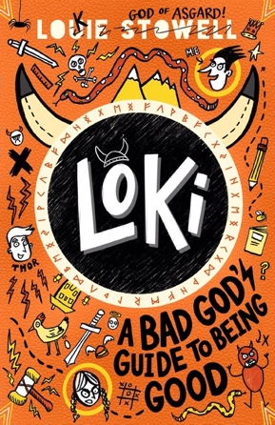
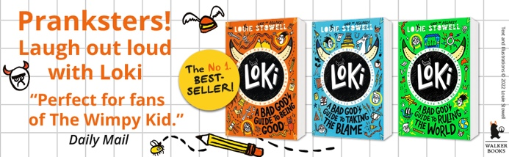

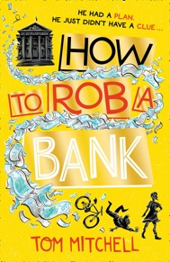

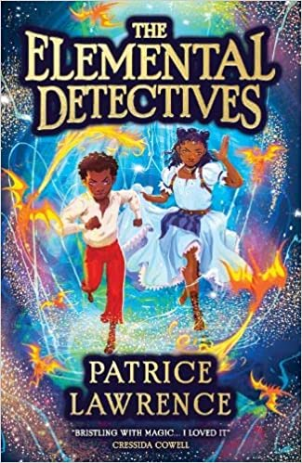
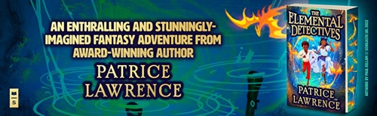
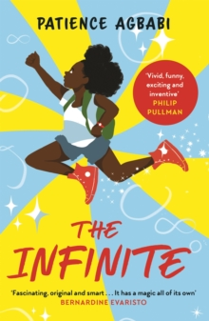


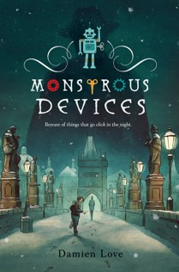
After one trick too may, Loki is banished to live on earth as a ‘normal’ schoolboy. Forbidden from using his AWESOME godly powers, Loki must show moral improvement. As he records his lies THE TRUTH in his magical (judgemental) diary, it becomes clear Loki hasn’t a clue how to tell good from evil, trust from tricks or friends from enemies.
Loki by Louie Stowell
If this sounds good then you could also read…
My Dad is Definitely Not a Crime Lord by Ben Davis
The Super Miraculous Journey of Freddie Yates by Jenny Pearson
Inkling by Kenneth Oppel
How to Rob a Bank by Tom Mitchell
Step into a London lit up by the Elemental spirits: the fiery Dragons, the airy Fumis, the watery Chads and the earthbound Magogs. But humans have been causing chaos for centuries, trampling through the landscape trailing noise, mess and pollution. What if the Elements could slow down this new world…or stop it all together?
The Elemental Detectives by Patrice Lawrence
The Infinite by Patience Agbabi
Knights and Bikes by Gabrielle Kent
The Light Hunters by Dan Walker
Monstrous Devices by Damien Love

Slide 4

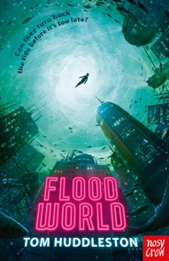
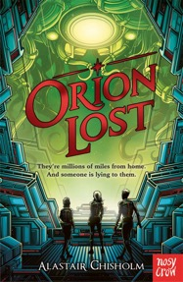
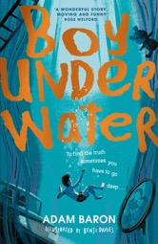
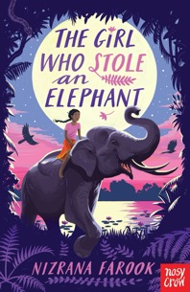

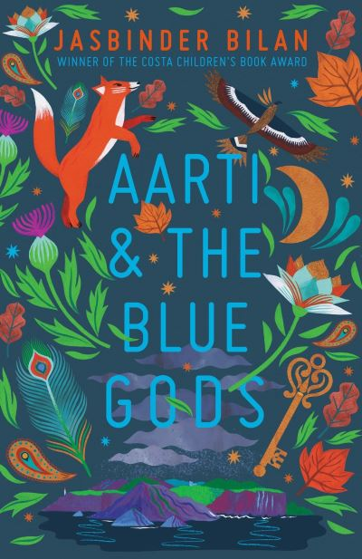
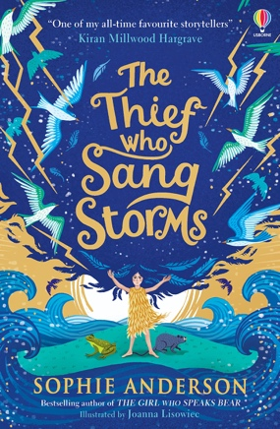
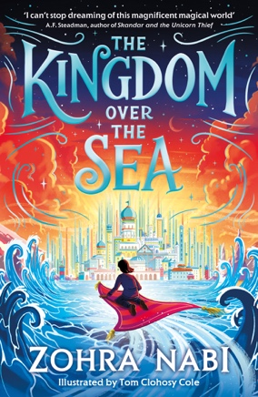

Twelve-year-old Addison Cooke just wishes something exciting would happen to him. His aunt and uncle, both world-famous researchers, travel to the ends of the earth searching for hidden treasure, dodging dangerous robbers, while Addison is stuck in school. Luckily for Addison, adventure has a way of finding the Cookes. After his uncle unearths the first ancient Incan clue needed to find a vast trove of lost treasure, he is kidnapped by members of a shadowy organization intent on stealing the riches. Addison's uncle is the bandits' key to finding the treasure . . . unless Addison and his friends can outsmart the kidnappers and crack the code first. This is a story full of laugh-out-loud moments and nonstop action.
Addison Cooke and the Treasure of the Incas by Jonathan Stokes
If this sounds good then you could also read…
FloodWorld by Tom Huddlestone
Orion Lost by Alistair Chisholm
Boy Underwater by Adam Baron
Beetle Boy by M.G. Leonard
Chaya, a no-nonsense, outspoken hero, leads her friends and a gorgeous elephant on a noisy, fraught, joyous adventure through the jungle where revolution is stirring and leeches lurk. Will stealing the queen's jewels be the beginning or the end of everything for the intrepid gang?
The Girl Who Stole An Elephant by Nizrana Farook
Aarti & the Blue Gods by Jasbinder Bilan
The Thief who Sang Storms by Sophie Anderson
The Kingdom over the Sea by Zohra Nabi
The Star Outside my Window by Onjali Q Rauf

Slide 5
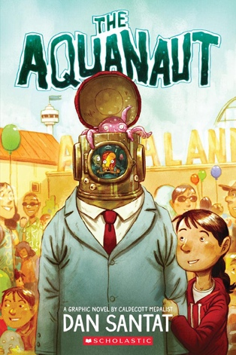
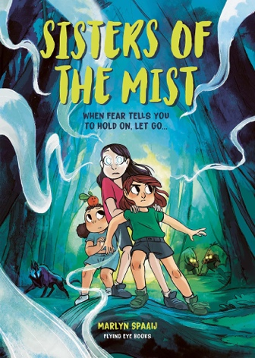





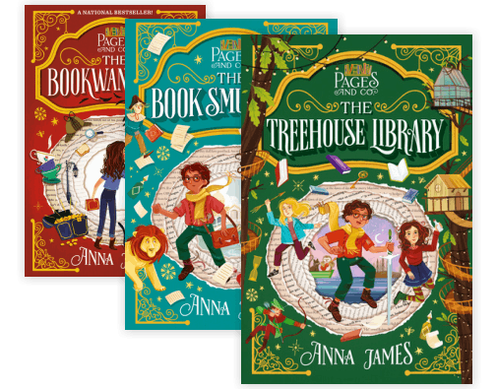

Graphic Novels
The Aquanaut by Dan Santat
Sisters of the Mist by Marlyn Spaaij
City of Dragons by Jaimal Yogis
Running. That's all Ghost (real name Castle Cranshaw) has ever known. But Ghost has been running for the wrong reasons - until he meets Coach, an ex-Olympic Medallist who sees something in Ghost: crazy, natural talent. If Ghost can stay on track, literally and figuratively, he could be the best sprinter in the city. Can Ghost harness his raw talent for speed, or will his past finally catch up to him?
Ghost by Jason Reynolds
The Kick Off by Dan Freedman
After the War by Tom Palmer
Owen and the Soldier by Lisa Thompson
Can you Feel the Noise by Stewart Foster
Super Series
Pages & Co by Anna James
Twitch, Spark & Clutch by MG Leonard

Slide 6

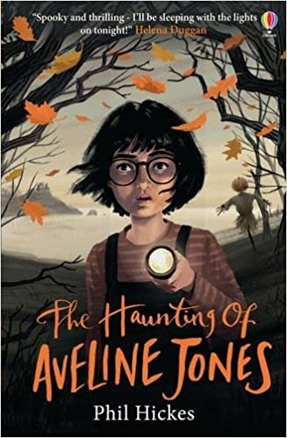
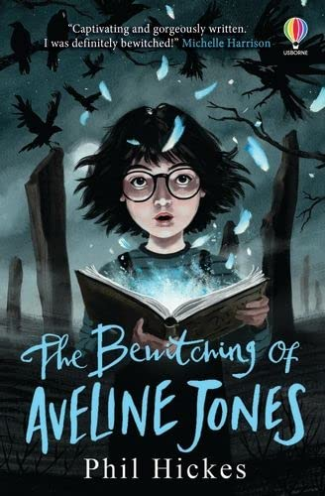
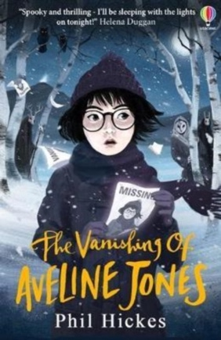
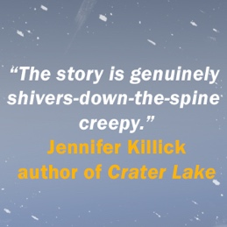
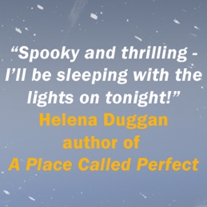
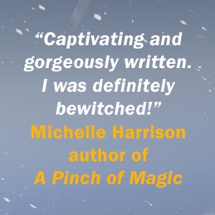
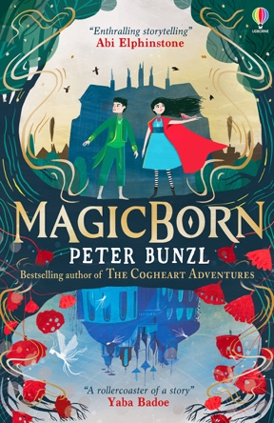
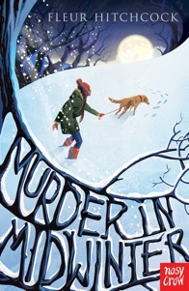
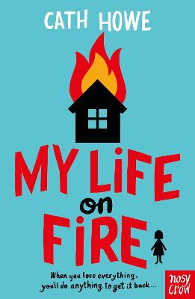
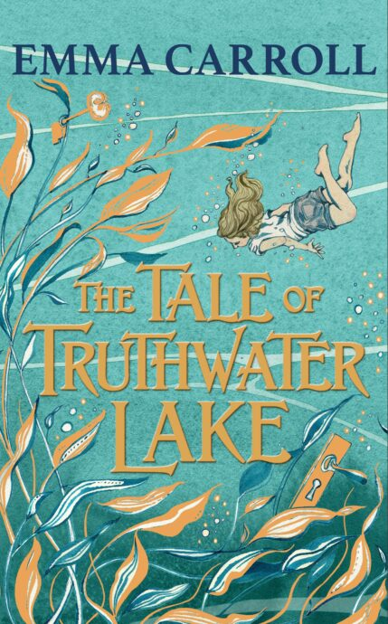
To aid his recovery from a life-threatening illness, Jordan and his family move out of the city for a healthy new start. Jordan's getting enough funny looks as the new boy at school as it is, without his Mum giving him homemade soup every day for lunch! But when Ethan meets a homeless man called Harry, and gives him the soup, it is the start of an unlikely friendship.
The Soup Movement by Ben Davis
Aveline Jones by Phil Earle
Magicborn by Peter Bunzl
Murder in Midwinter by Fleur Hitchcock
My Life on Fire by Cath Howe
Planet Omar by Zanib Mian
On one side of the underwater street is the remains of a house…It’s beautiful here, and eerie, a lost kingdom, a ghost village…
It’s the near-future and Britain is having yet another heatwave. Of course, the government have put in the normal curfews for this kind of weather, and shops are forced to shut again. For Polly, it’s the sort of heat that makes her do wild, out-of-character things just to cool down. Like face her fear of deep water. Essential when she and her brother have been sent to their aunt’s eco lake-side house for the summer.
The Tale of Truthwater Lake by Emma Carroll

