Slide 1
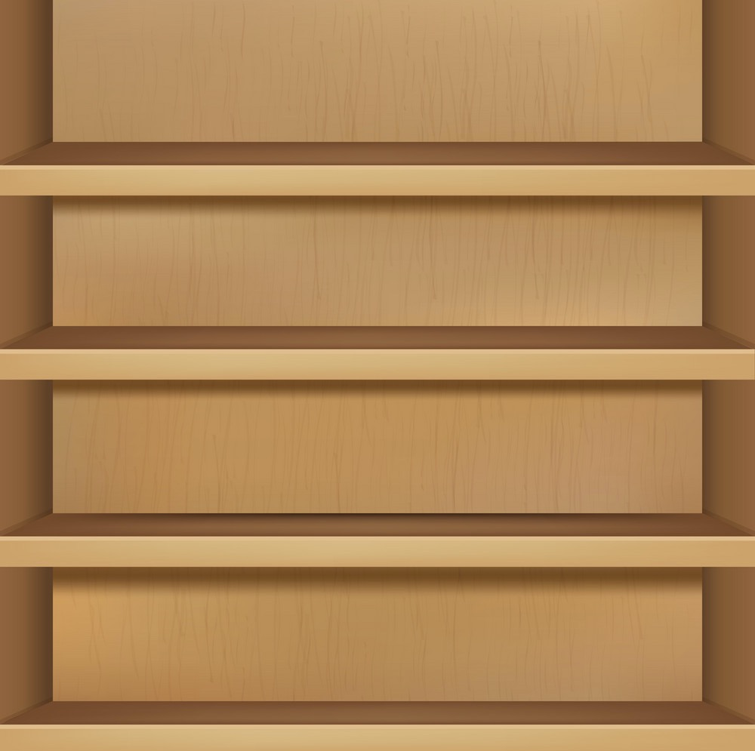

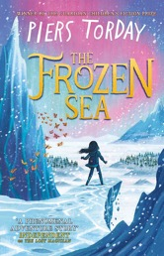
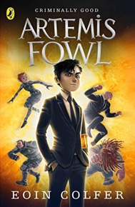
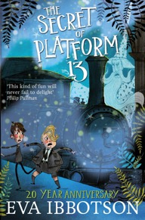
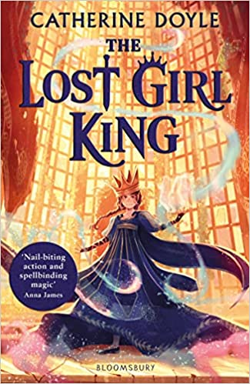
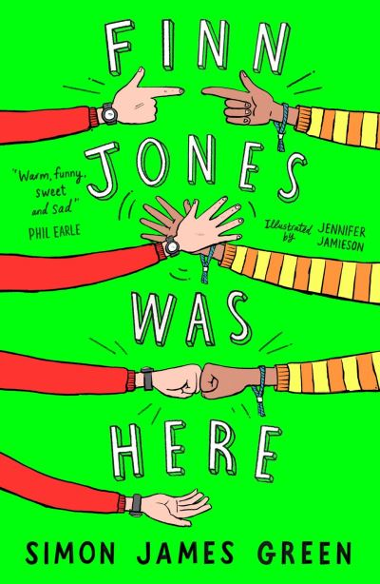

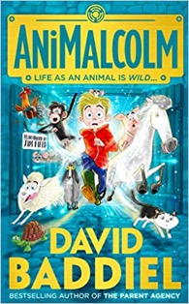
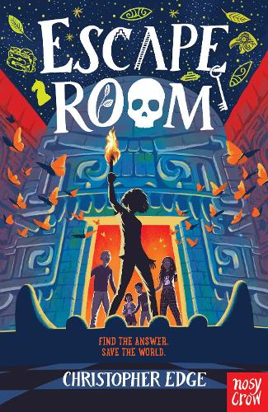
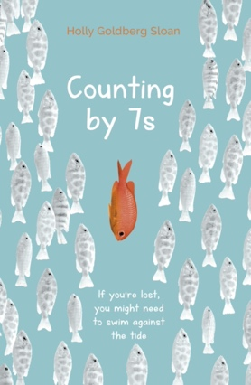
KS2 SAT Reading score of 105+
This story follows Jewel and her hilarious hamster, Fizz, who hide in an old bookshop to escape the bullies that are chasing her. Whilst inside, she stumbles across an unusual atlas which acts as a portal and transports her to Folio, a kind of enchanting Narnia. She meets a librarian who gives her an exciting but dangerous task; to rescue her Aunt Evie, the Empress of Folio. Jewel embarks on an adventure of a lifetime, where she learns some important truths along the way. The Frozen Sea is a story you will instantly fall in love with and will make your imagination run wild!
The Frozen Sea by Piers Torday
If this sounds good then you could also read…
Artemis Fowl by Eoin Colfer
The Secret of Platform 13 by Eva Ibbotson
The 100 by Kass Morgan
The Lost Girl King by Catherine Doyle
Eric’s best friend, Finn, was the world’s most enthusiastic prankster. Was, because Finn died recently of an illness…or did he? At Finn’s funeral, Eric receives a message from beyond the grave and it must be because this is Finn’s biggest prank ever, faking his own death! As Eric follows Finn’s cryptic instructions for various challenges, he goes down memory lane and through a scavenger hunt that will change Eric forever.
Finn Jones Was Here by Simon James Green
AniMalcolm by David Baddiel
Escape Room by Christopher Edge
See you in the Cosmos by Jack Cheng
Counting by 7s by Holly Goldberg Sloan

Slide 2


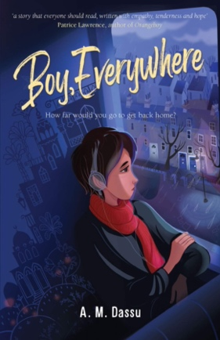
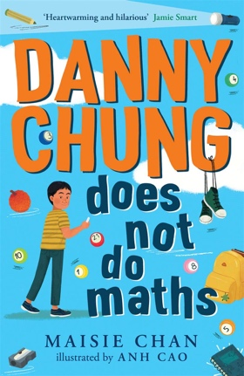
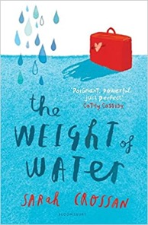
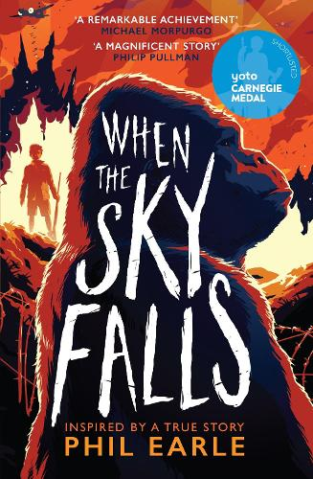


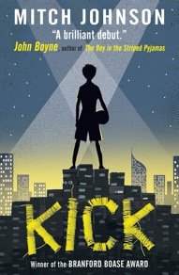
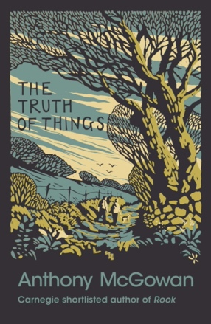
Aaliyah is an ordinary 13-year-old living in the Midlands – she’s into her books, shoes, K-pop and she is a Muslim. She has always felt at home where she lives…until a terrorist attack in her area changes everything. As racial tensions increase and she starts getting bullied, Aaliyah decides to begin wearing a hijab - to challenge how people in her community see her. But when her school bans the hijab and she is intimidated and attacked for her choices she feels isolated…
Fight Back by AM Dassu
If this sounds good then you could also read…
Boy, Everywhere by AM Dassu
Danny Chung does not do Maths by Maisie Chan
The Weight of the Water by Sarah Crossan
Do You Know Me by Libby Scott and Rebecca Westerfield
1941: War is raging. And one angry boy has been sent to the city, where bombers rule the skies. There, Joseph will live with Mrs F, a gruff woman with no fondness for children. Her only loves are the rundown zoo she owns and its mighty silverback gorilla, Adonis. As the weeks pass, bonds deepen and secrets are revealed, but if the bombers set Adonis rampaging free, will either of them be able to end the life of the one thing they truly love?
When the Sky Falls by Phil Earle
The Boy Who Didn’t want to Die by Peter Lantos
Kick by Mitch Johnson
The Truth of Things by Anthony Magowan
Troofriend by Kirsty Applebaum

Slide 3

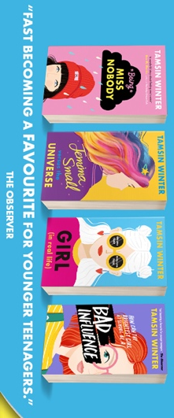
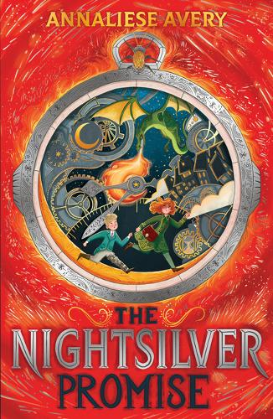
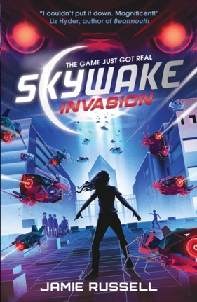
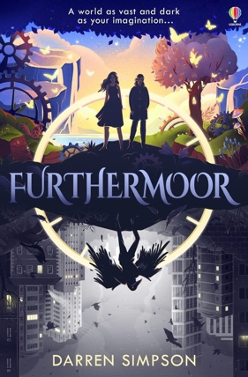
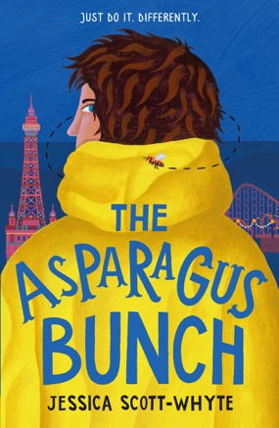
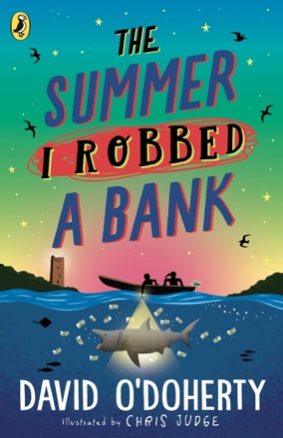
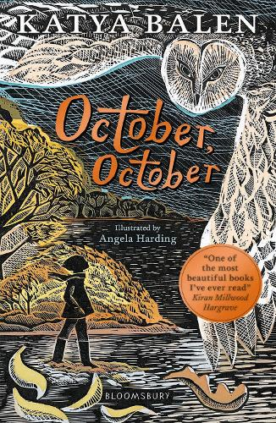
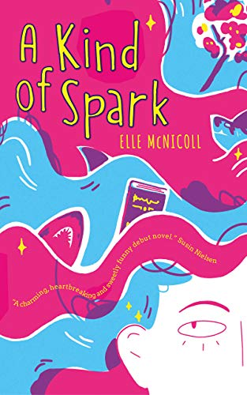
Eva has been public property since before she was born. Her parents’ vlog All About Eva has documented everything: first words, first tantrum and first pimple.
When she was small, Eva didn’t mind posing for pictures or acting up for the camera, but now she’s a young teen, she just wants some privacy. When Mum vlogs about Eva’s first period, the embarrassment is too much to bear and Eva is forced to take drastic action in order to get her life back.
Girl (In Real Life) by Tamsin Winter
The Nightsilver Promise by Annalise Avery
Skywake Invasion by Jamie Russell
The Infinite Lives of Maisie Day by Christopher Edge
Furthermoor by Darren Simpson
Leon John Crothers is 4779 days old (13 years and 1 month if you’re mathematically challenged). He has been ‘moved on’ from six different schools and most people think he has an attitude problem. Leon doesn’t care for the label, in the same way that he doesn’t care for Tim Burton, supermarket trolleys, train fanatics or Bounty bars. This time, however, things may turn out differently, as help comes from where he least expects it – Dr Snot, a physician at pains to help Leon navigate ‘normal’ and classmates, Tanya and Lawrence, who both face their own challenges.
The Asparagus Bunch by Jessica Scott-Whyte
The Summer I Robbed the Bank by David O’Doherty
October, October by Katya Balen
A Kind of Spark by Elle McNicoll
A Seven Letter Word by Kim Slater

Slide 4

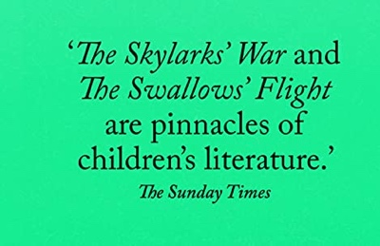
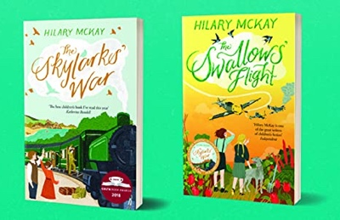
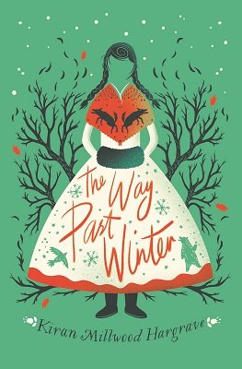
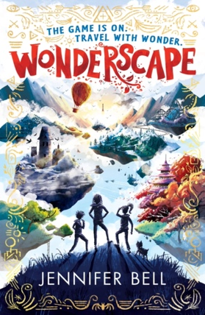
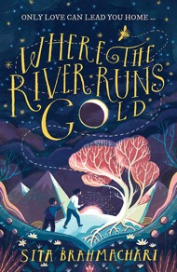
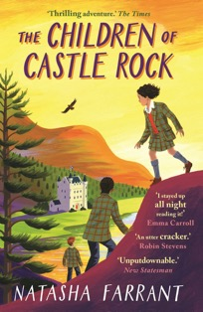
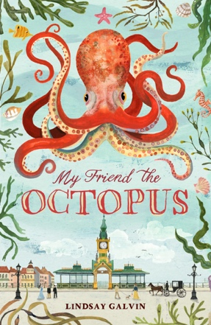
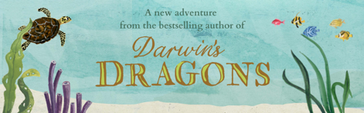
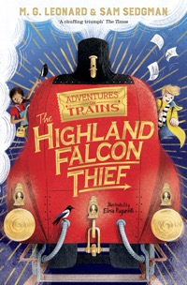
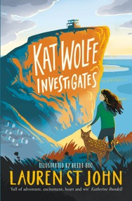
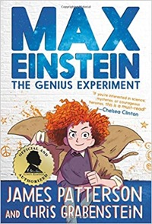
Erik and Hans are German boys. Ruby and Kate are English girls. They grow up in worlds that would never meet, until war tumbles their lives together. Then one September afternoon there are choices to be made.
How is courage lost and found? Who is really the enemy? And what does friendship truly mean, in the middle of a war?
Meanwhile Rupert and Clarry work secretly for peace – and a brighter future for them all…
The Swallow's Flight by Hilary McKay
If this sounds good then you could also read…
Where the River Runs Gold by Sita Brahmachari
The Children of Castle Rock by Natasha Farrant
The Way Past Winter - Kiran Millwood Hargrave
Wonderscape by Jennifer Bell
England 1877 and aquarium fever is at it’s height.
12-year-old Vinnie Fyfe works in a tea-shop at Brighton aquarium, and waits for her milliner mother to return from Paris. The arrival of a giant octopus changes her life forever. Discovering a talent for art, Vinnie begins to draw the extraordinary beast. She soon realises she can communicate with the octopus through colour and – as a gripping mystery begins to unfold – discovers what true courage really means.
My Friend the Octopus by Lindsay Galvin
The Highland Falcon Thief by M.G. Leonard
Kat Wolfe Investigates by Lauren St John
The Genius Experiment by James Patterson
Thornhill by Pam Smy

Slide 5
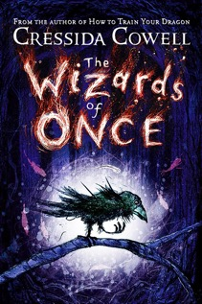
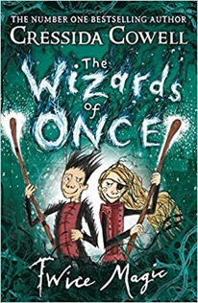
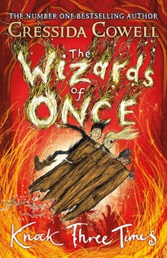
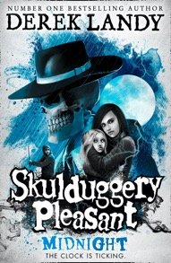
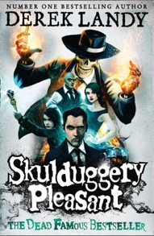

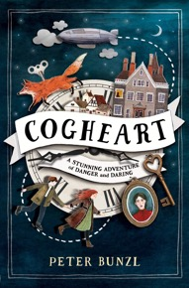
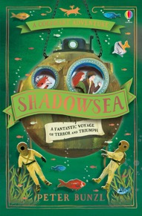
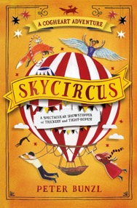

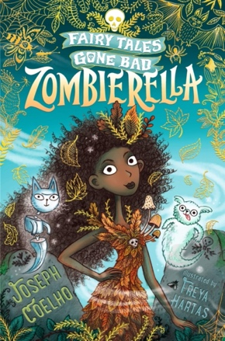
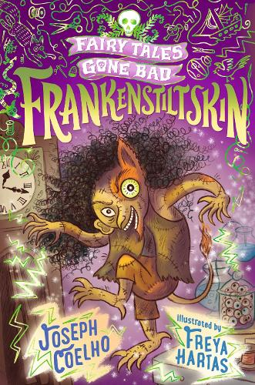
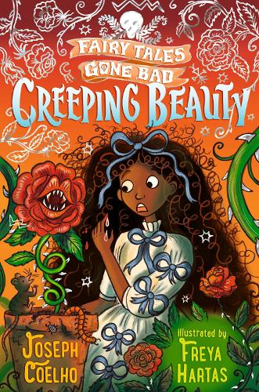
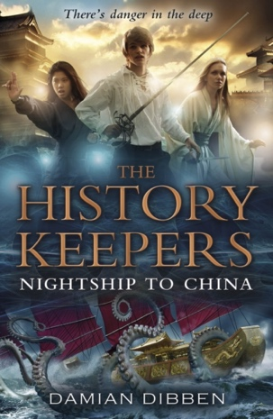
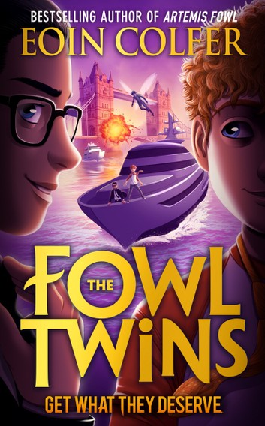
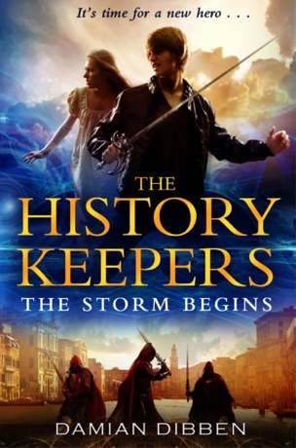
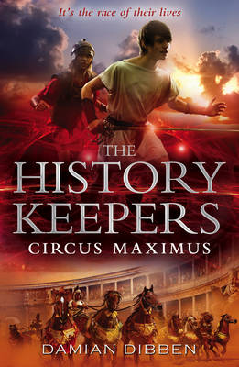
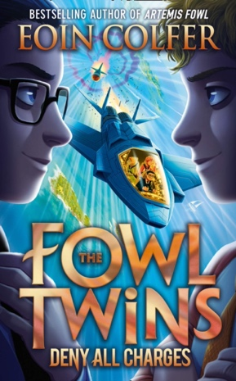


The Wizards of Once by Cressida Cowell
A Murder Most Unladylike by Robin Stevens
Skulduggery Pleasant by Derek Landy
Cogheart Adventure by Peter Bunzl
Fairy Tales Gone Bad by Joseph Coelho
The Chocolate Box Girls by Cathy Cassidy
Super Series
The History Keepers by Damian Dibben
The Fowl Twins by Eoin Colfer

Slide 6







Thirteen-year-old Skandar Smith has only ever wanted to be a unicorn rider. To be one of the lucky few selected to hatch a unicorn. To bond with it for life; to train together and race for glory; to be a hero.
But just as Skandar’s dream is about to come true, things start to take a more dangerous turn than he could ever have imagined. A dark and twisted enemy has stolen the Island’s most powerful unicorn – and as the threat grows ever closer, Skandar discovers a secret that could blow apart his world forever . . . Get ready for unlikely heroes, elemental magic, sky battles, ancient secrets, nail-biting races and ferocious unicorns, in this epic adventure series that will have your heart soaring.
Skander and the Unicorn Thief by A F Steadman
Mia and the Lightcasters by Janelle McCurdy
The Marvellers by Dhonelle Clayton
Onyeka series by
Tola Okogwu
Amari Peters knows three things. Her brother Quinton has gone missing. No one will talk about it. His mysterious job holds the secret. So when Amari gets an invitation to the Bureau of Supernatural Affairs, she’s certain this is her chance to find Quinton. But first she has to get her head around the new world of the Bureau, where mermaids, aliens and magicians are real, and her roommate is a weredragon.
Amari and the Night Brothers by BB Alston

